Slide 1


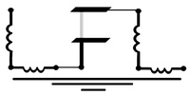





Learning the Inverse Design Map: $\hat{H}$ to designs
Sadman Ahmed Shanto
Superconducting Qubit And Device Design and Simulation database
Notes:
Pedagogical. Ask questions
Low emphasis on equations/math – the workflow and the high level idea is what to go for.
Shoutout for job/research areas.

Slide 2
Outline
Very quick introduction to SQuADDS
Understanding the Inverse Design Problem
Understanding Interpolation problem
A crash course into the relevant ML tools: Feature engineering, LASSO, MLPs, KANs
Workshop: Using ML and SQuADDS to solve the inverse design and interpolation problems

Slide 3

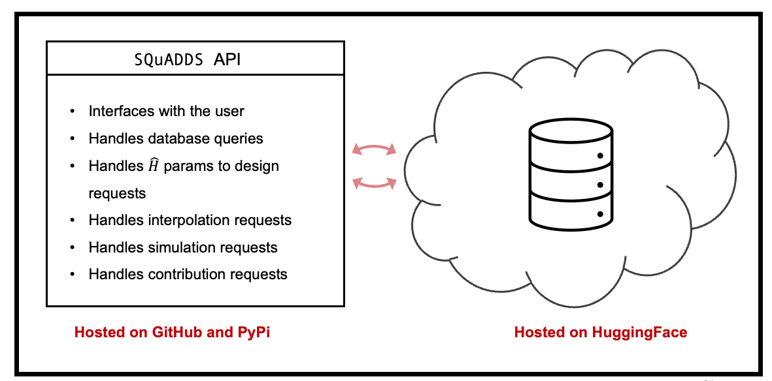





SQuADDS Structure:
Characterization
Measurements
Simulation
results
Fabrication
Recipes
Simulation
parameters
Device
designs
🤗

Slide 4
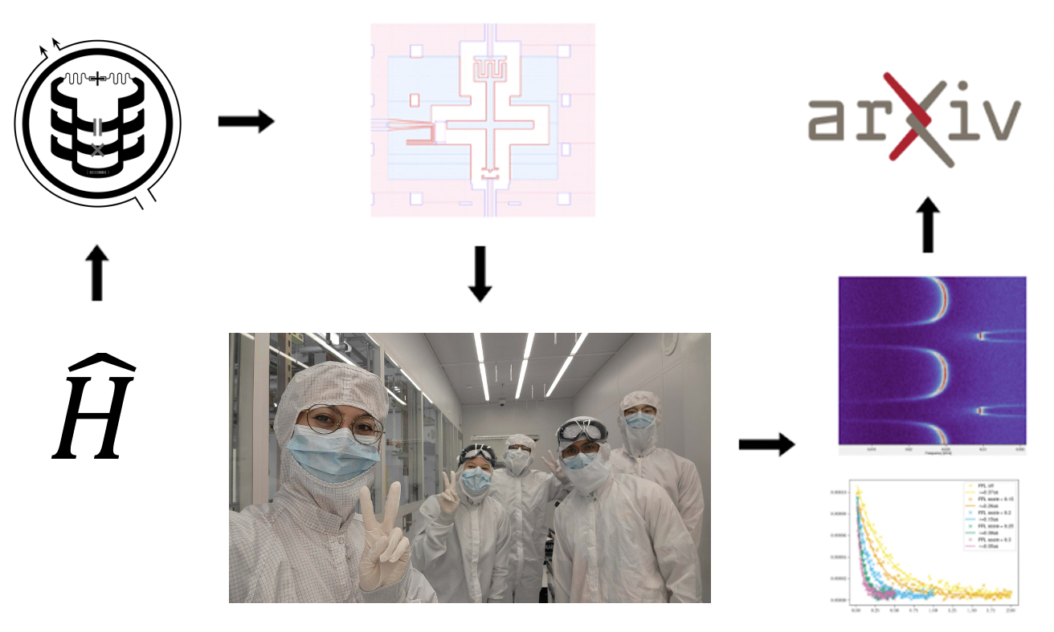
SQuADDS Workflow:
2

Slide 5
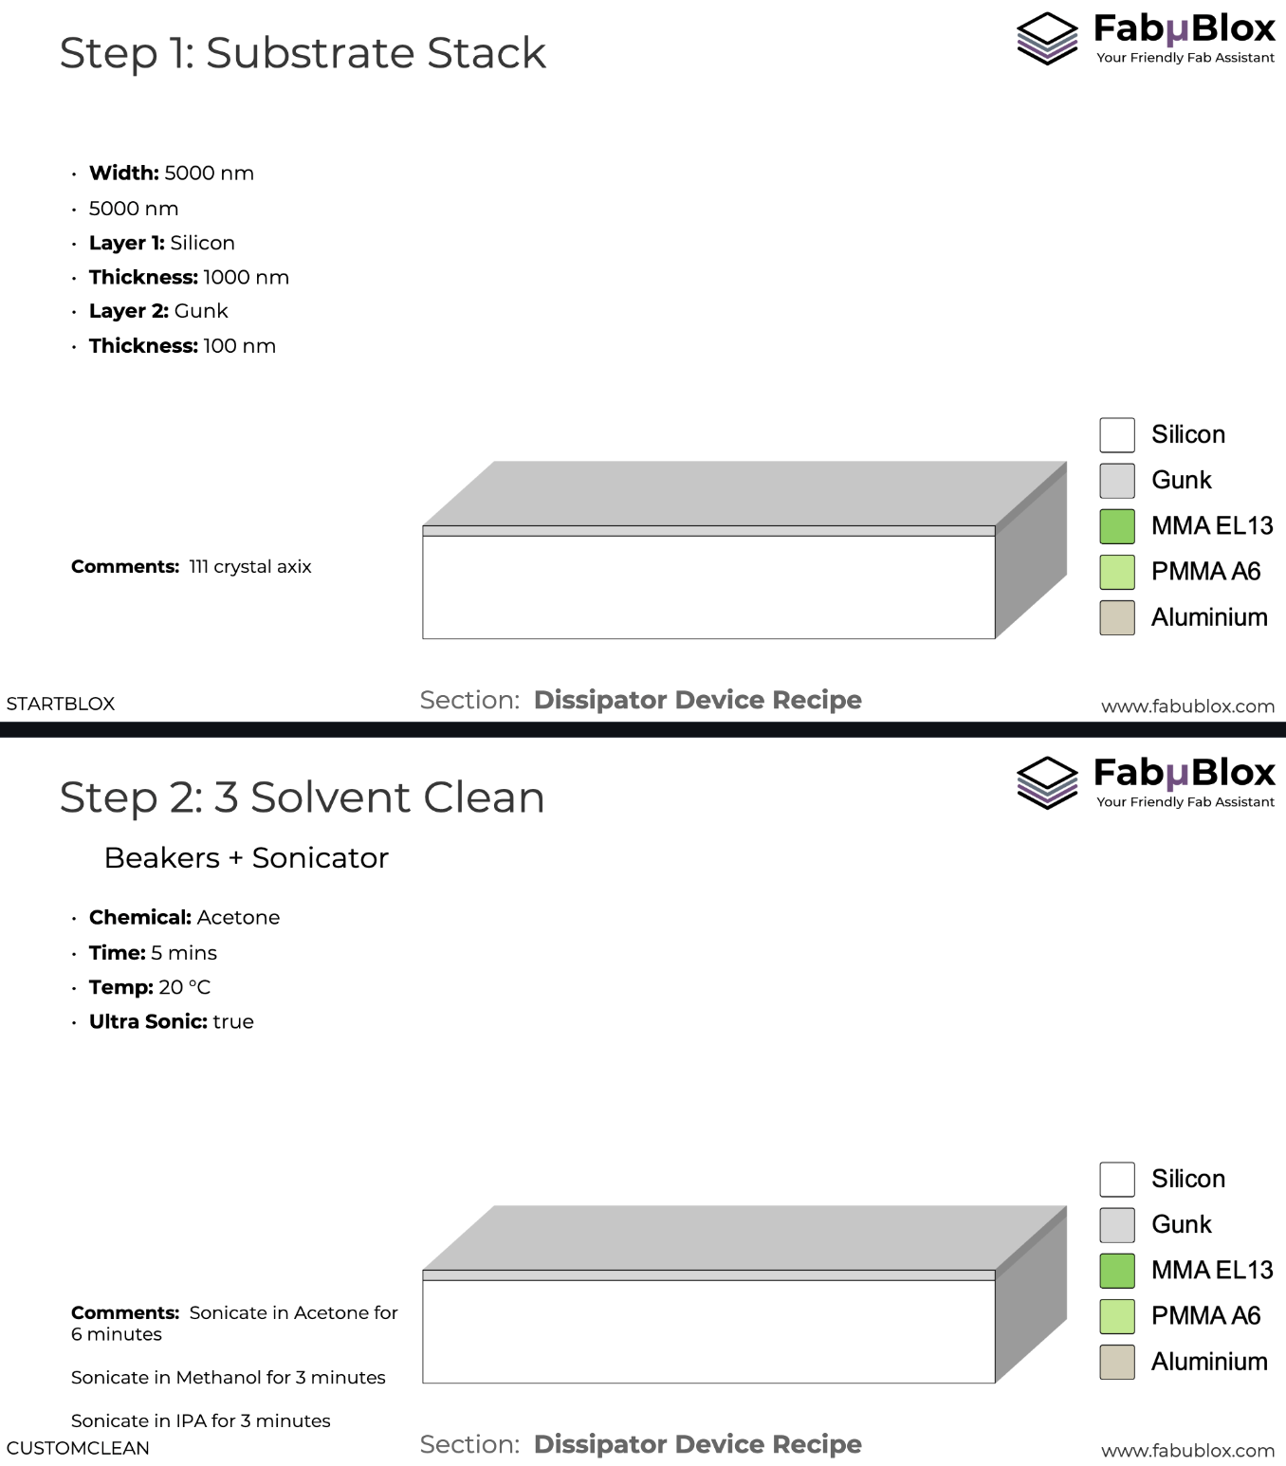
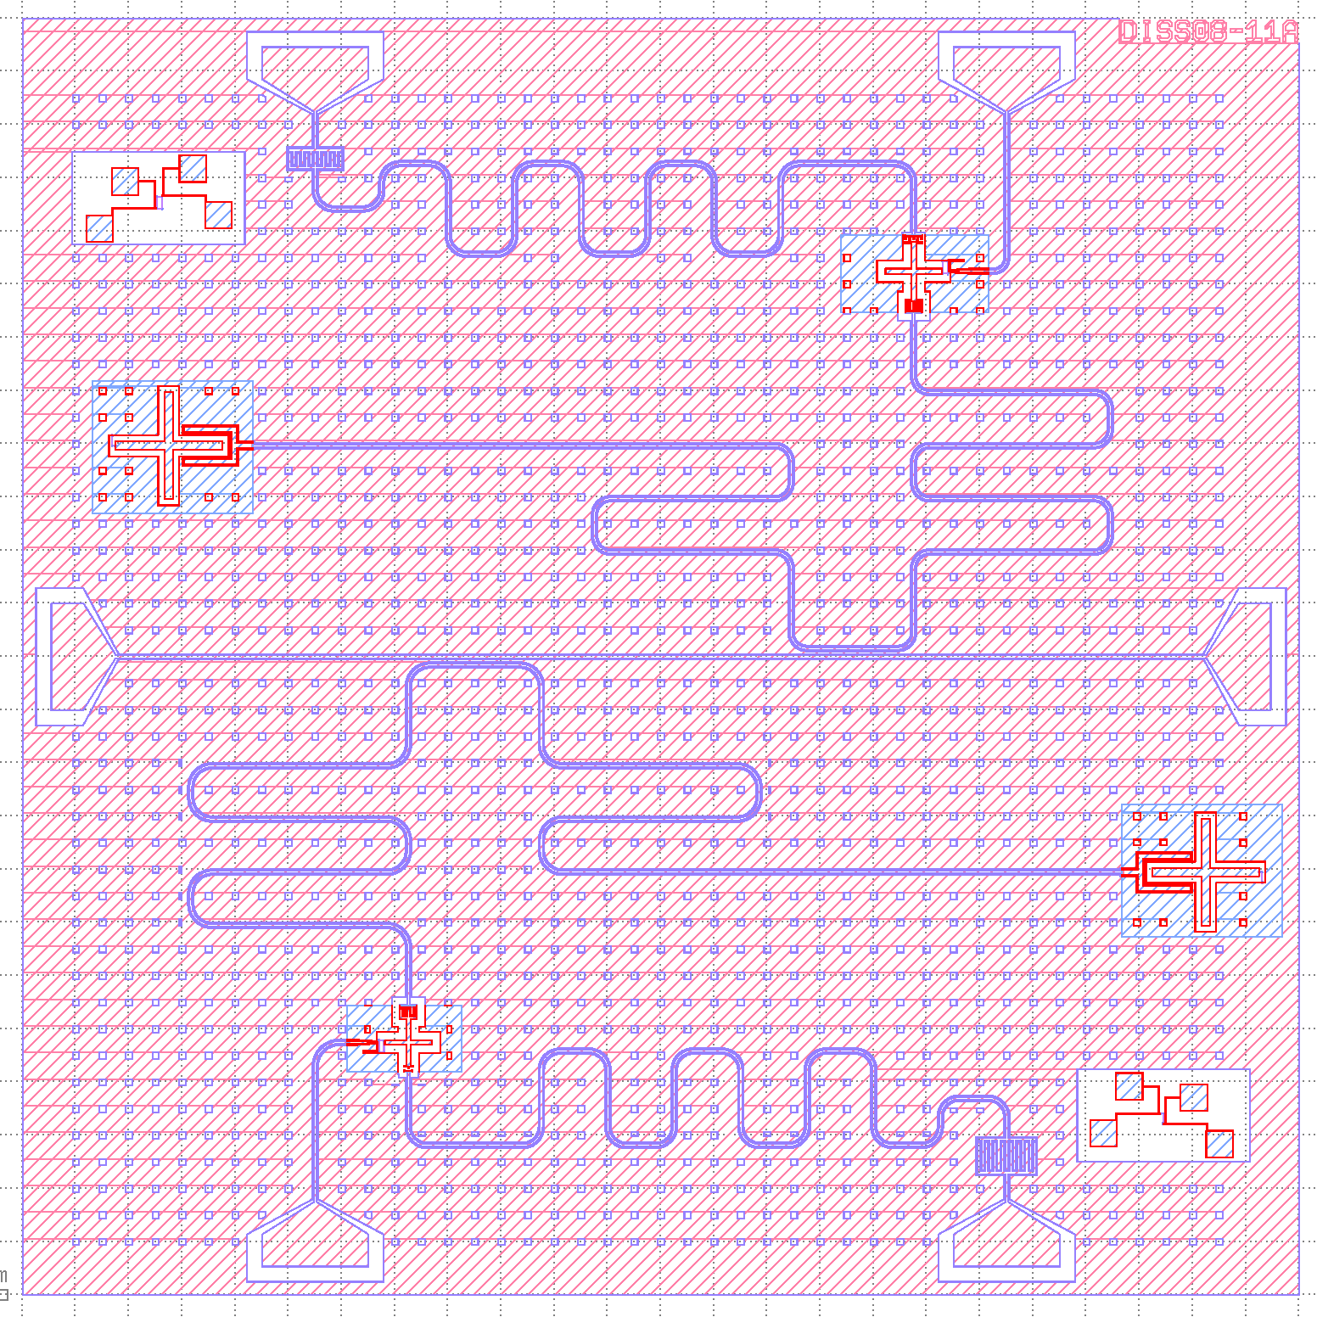
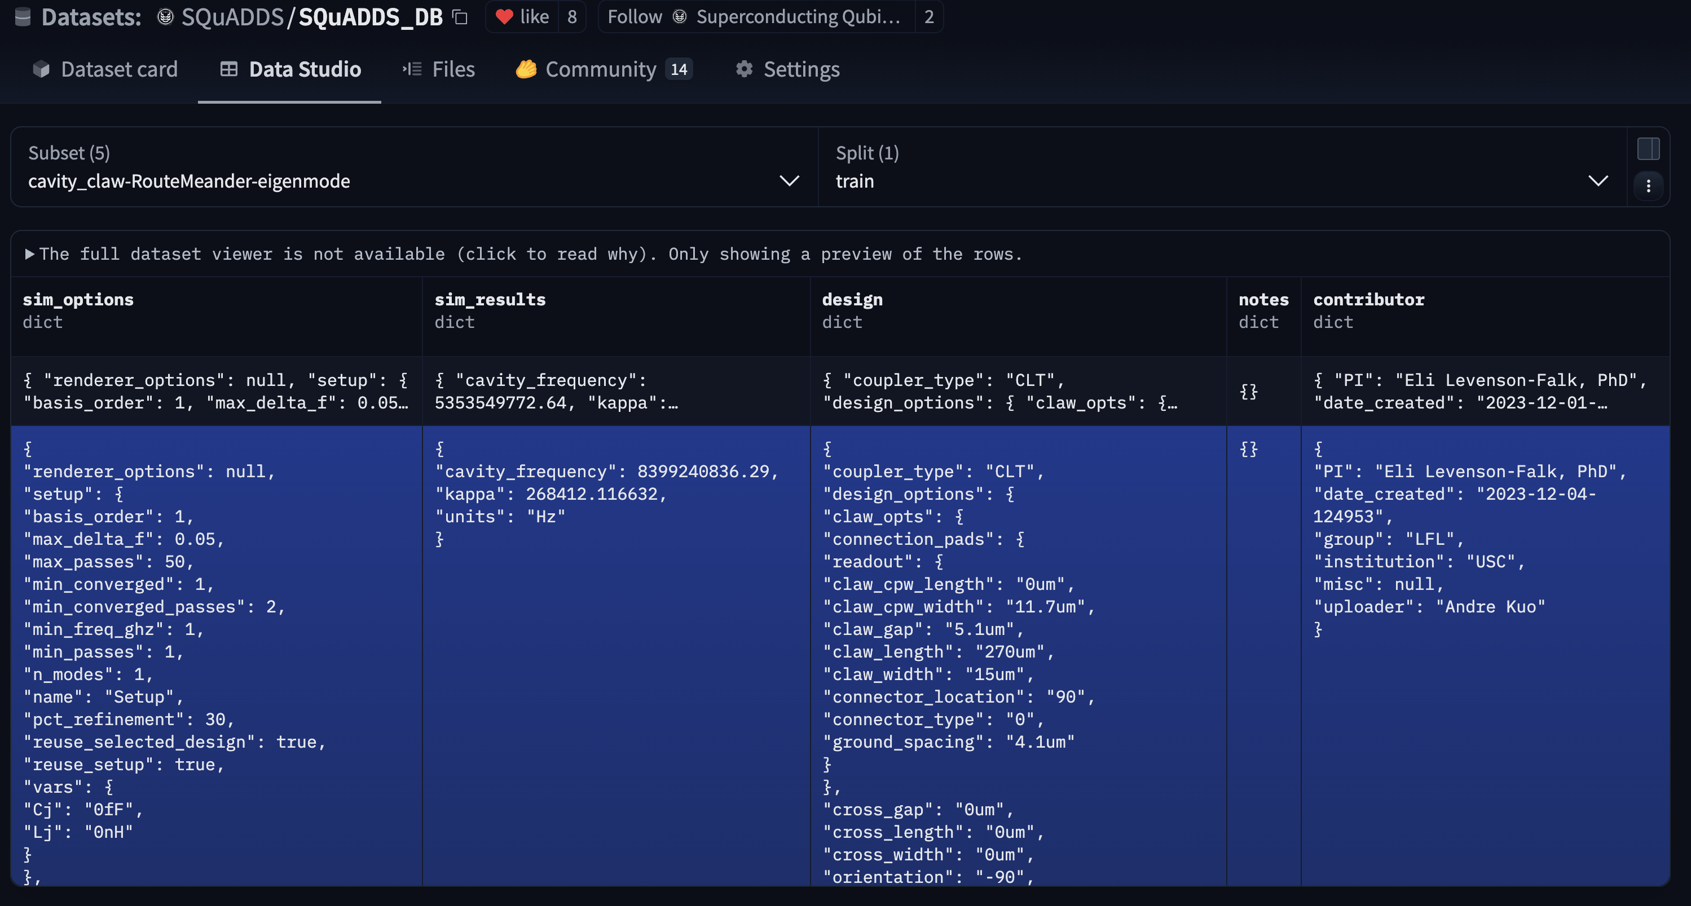
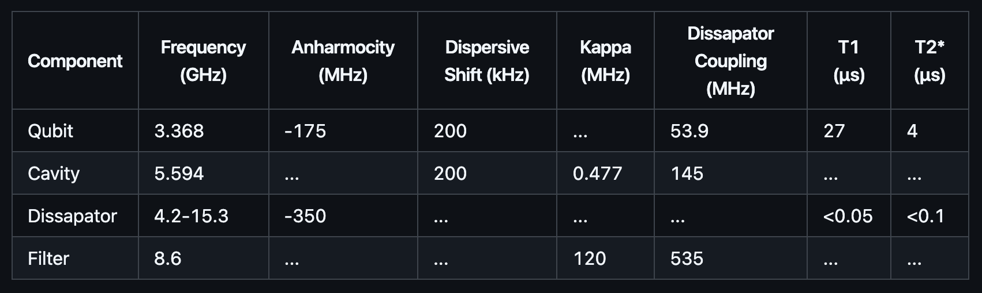
SQuADDS Database:
Device design code and files
Device characterization measurements
Validated simulation results
Fabrication Recipes

Slide 6
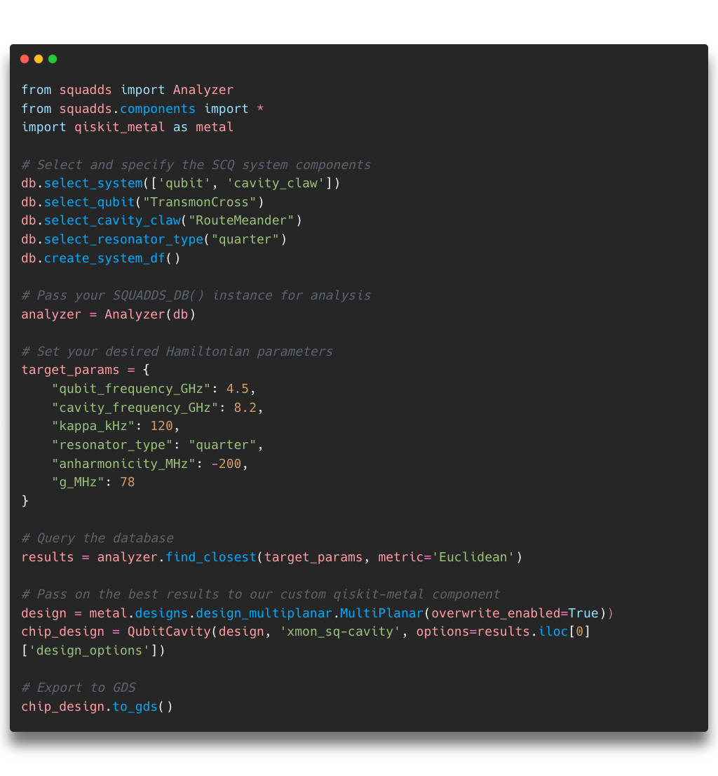
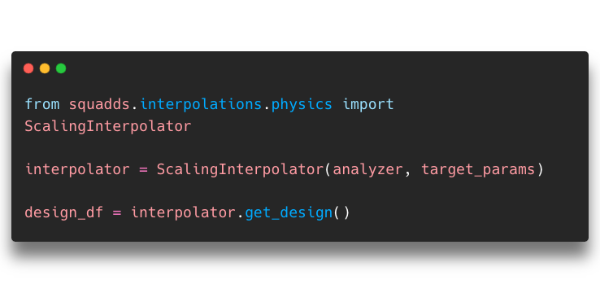
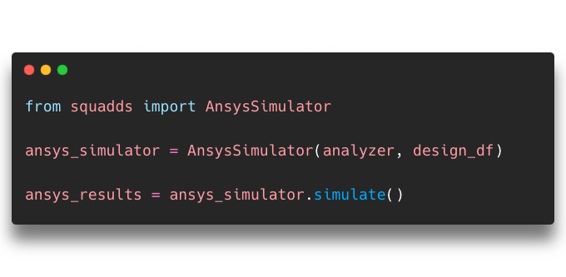
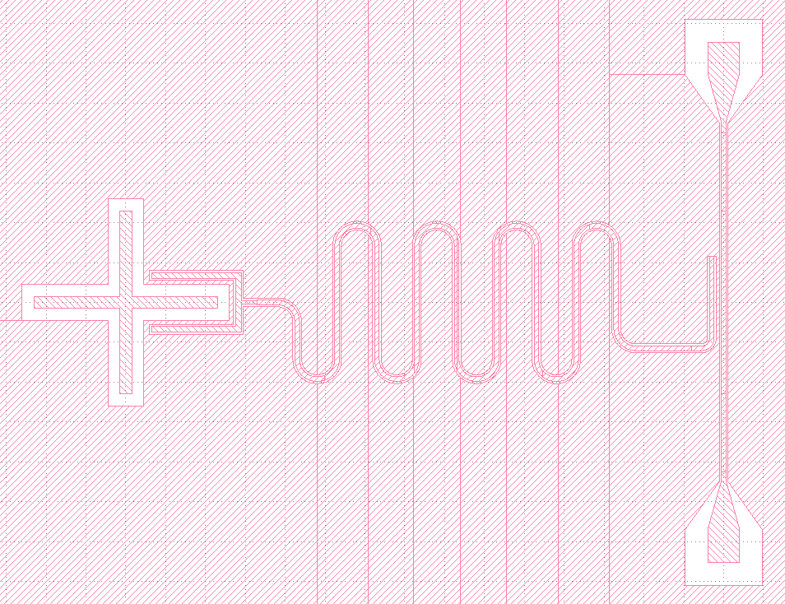

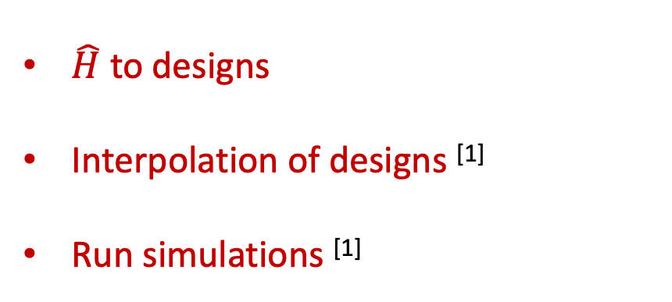
SQuADDS API:
$\hat{H}$ to designs
Interpolation of designs ^{[1]}
Run simulations ^{[1]}
^{[1]} Shanto Et al., https://quantum-journal.org/papers/q-2024-09-09-1465/
6

Slide 7
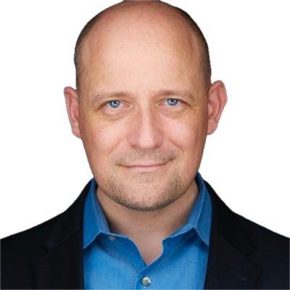



Standing on the shoulders of open-source giants:
All of Us

Slide 8
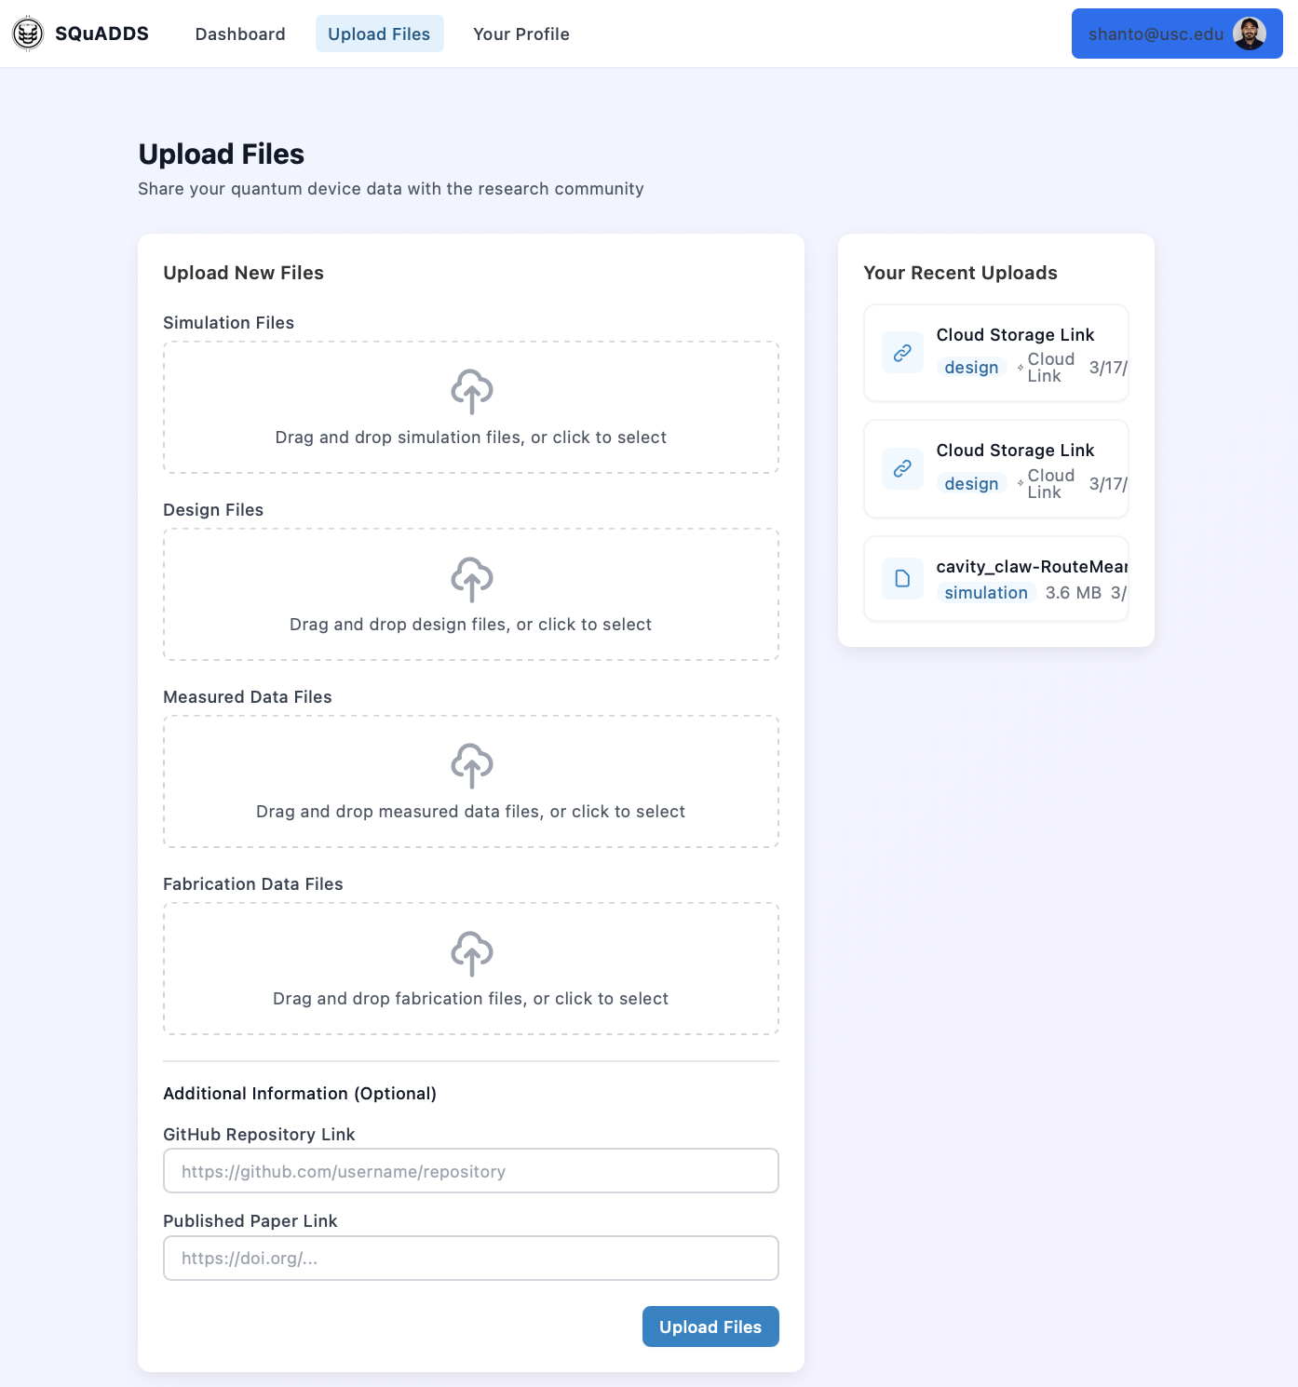


Contribution Portal:
squadds-portal.vercel.app

Slide 9

Me 🫶 SQuADDS Contributors:

Slide 10
What You Can Contribute:
Device designs (design code, .gds/.dxf files)
Validated simulation and measurement results (.aedt files, *.*)
Fabrication recipes (text-based/workflow pictures/Fabublox link)
New feature implementations (GitHub PRs)

Slide 11
The design problem:
Given a design, what Hamiltonian does it implement?
Hamiltonian Space
Design Space
Hard but at least uniquely defined

Slide 12
The inverse design problem:
Given a point in $\hat{H}$space how do we find the associated point in design space?
Hamiltonian Space
Design Space
Very underdefined problem!

Slide 13
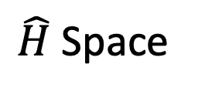


Interpolation Problem:
SQuADDS
Closest design space parameters for a user specified ($\hat{H}, metric)$
Physics based interpolation works extremely well for certain systems ^{[1]}
Target $\hat{H}$
Interpolated
Design
$\hat{H}$ Space
Design Space
^{[1]} Shanto Et al., https://quantum-journal.org/papers/q-2024-09-09-1465/
7

Slide 14
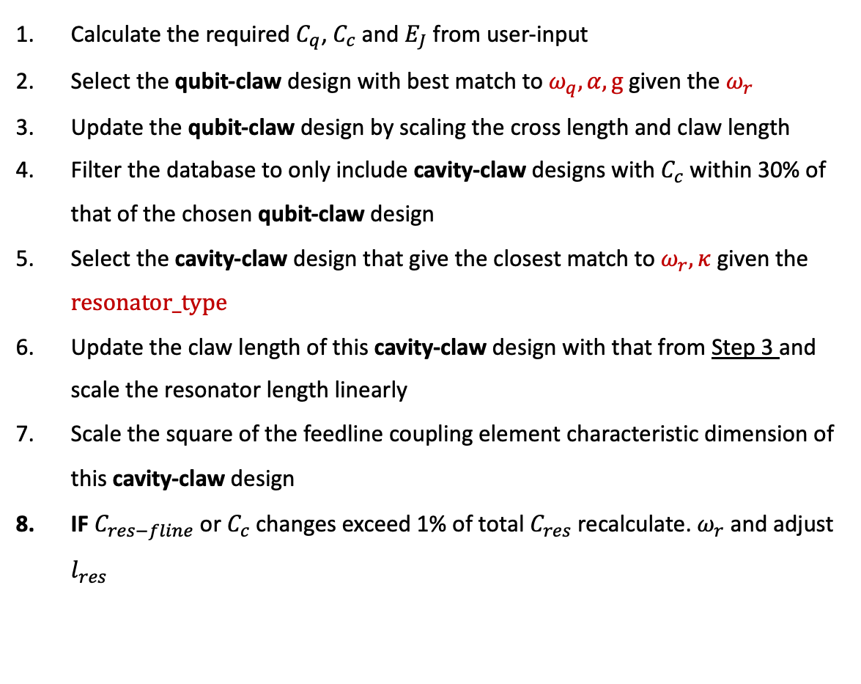
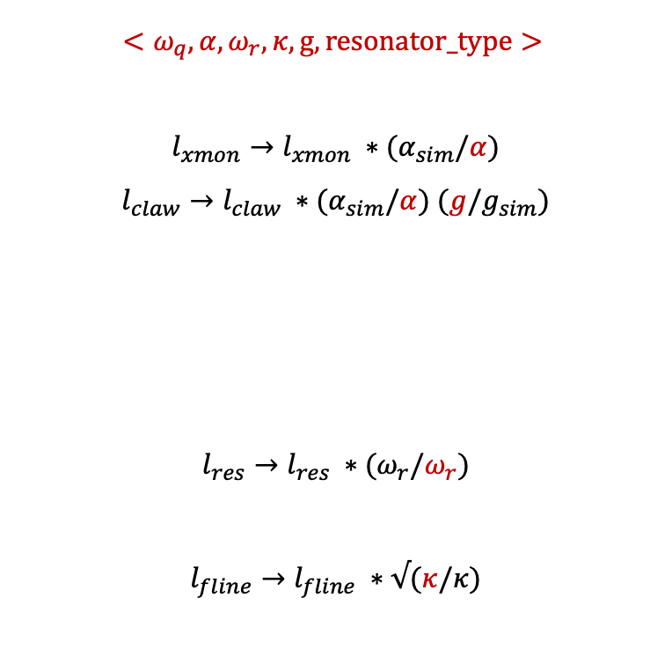
Interpolation Algorithm
Calculate the required $C_{q}$, $C_{c}$and $E_{J}$ from user-input
Select the qubit-claw design with best match to $ω_{q},α, g$ given the $ω_{r}$
Update the qubit-claw design by scaling the cross length and claw length
Filter the database to only include cavity-claw designs with $C_{c}$within 30% of that of the chosen qubit-claw design
Select the cavity-claw design that give the closest match to $ω_{r},κ$ given the $resonator_type$
Update the claw length of this cavity-claw design with that from Step 3 and scale the resonator length linearly
Scale the square of the feedline coupling element characteristic dimension of this cavity-claw design
IF $C_{res−fline}$or $C_{c}$changes exceed 1% of total $C_{res}$ recalculate. $ω_{r}$ and adjust $l_{res}$
$${<ω}_{q},α, ω_{r},κ,g,resonator_type>$$
$$l_{xmon}→l_{xmon} ∗(α_{sim}/α)$$
$l_{claw}→l_{claw} ∗(α_{sim}/α)$ $(g/g_{sim})$
$$l_{res}→l_{res} ∗(ω_{r}/ω_{r})$$
$$l_{fline}→l_{fline} ∗√(κ/κ)$$

Slide 15
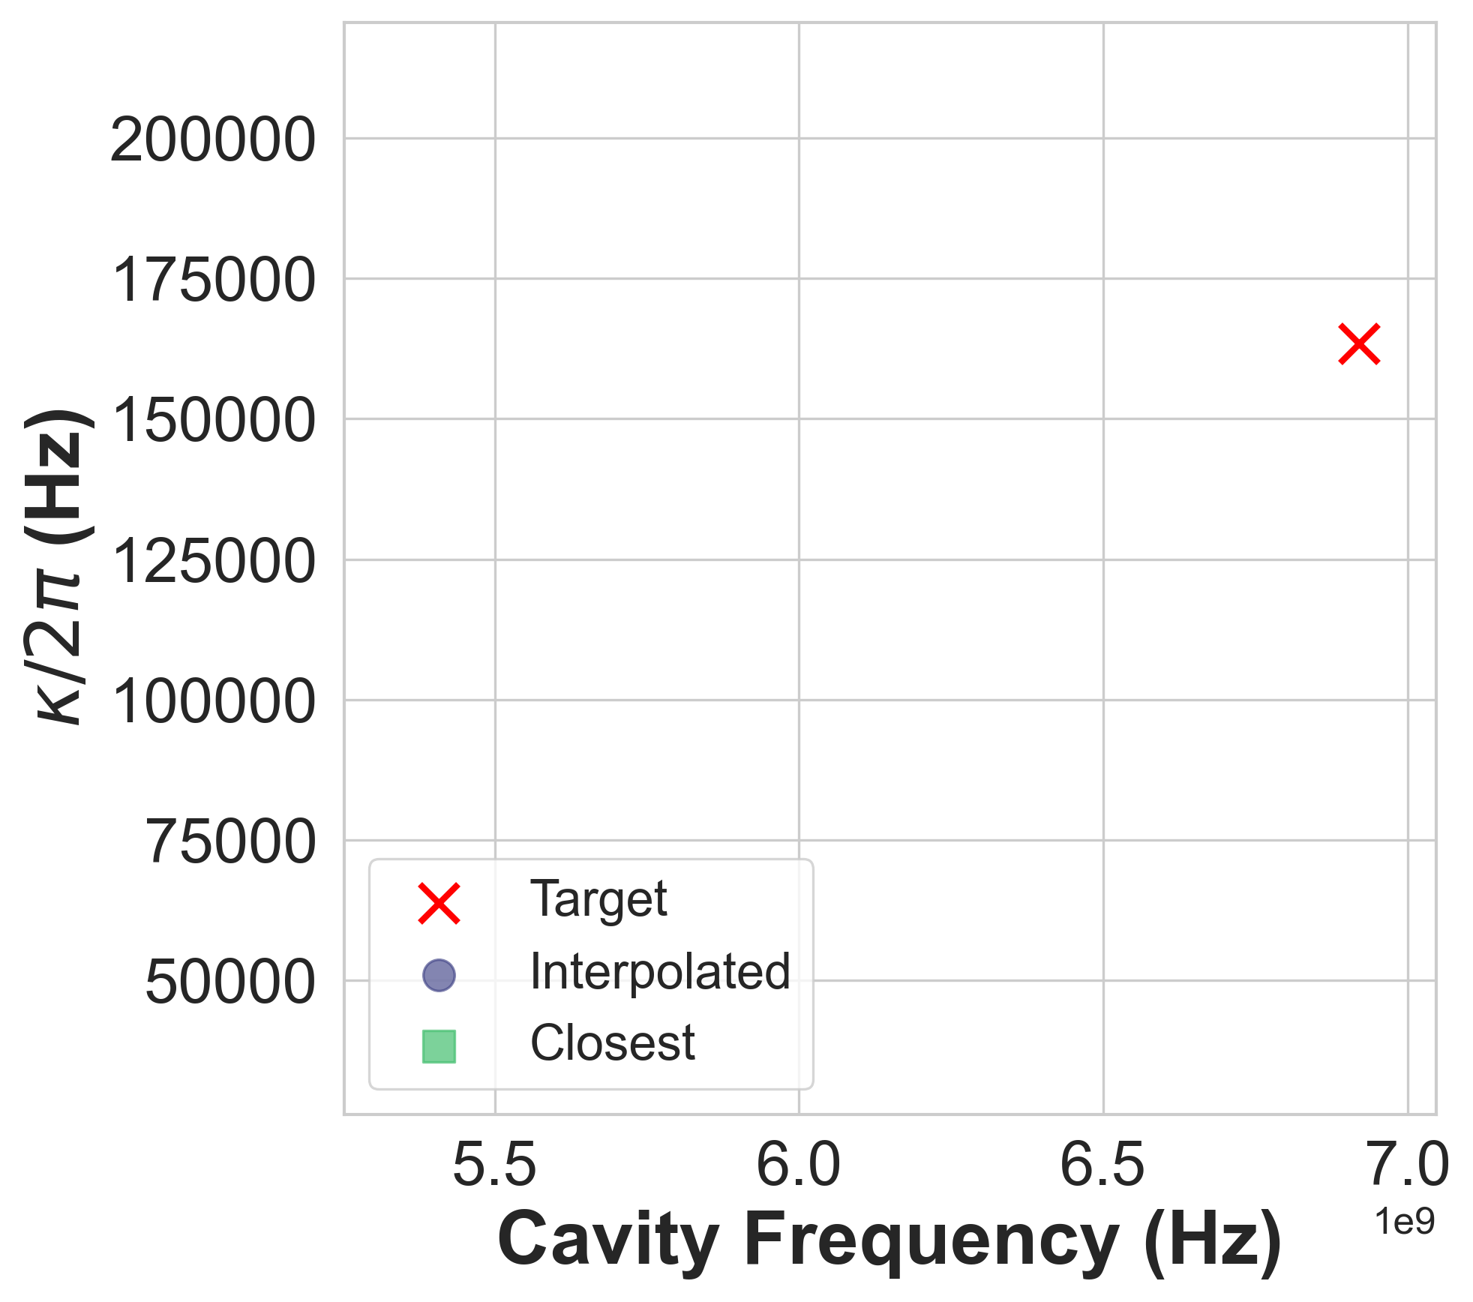
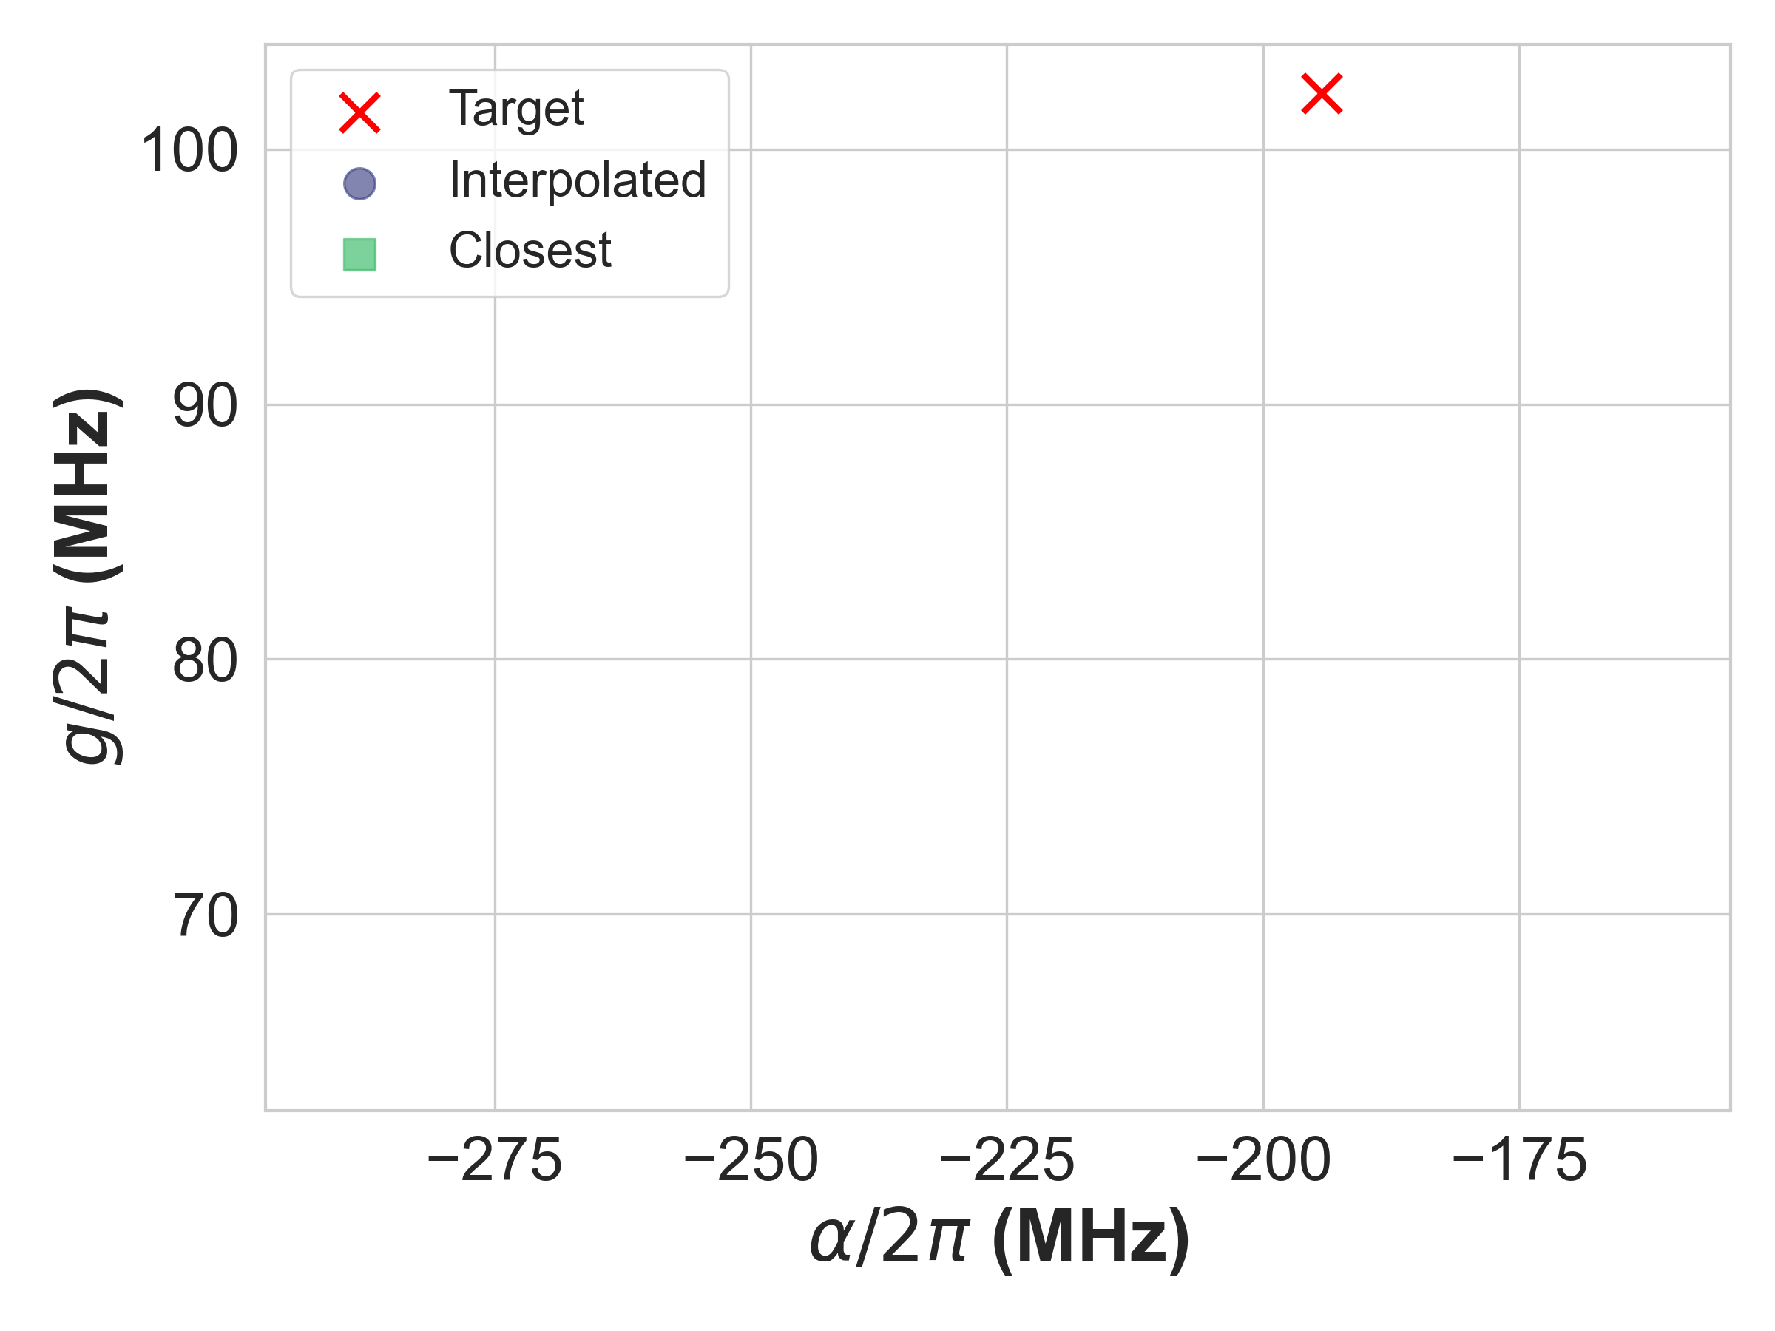
Interpolation Algorithm Validation
Choose Target $\hat{H}$ point
Notes:
To validate the reliability of the algorithm we run some simulation tests.
We first choose some target Hamiltonian

Slide 16
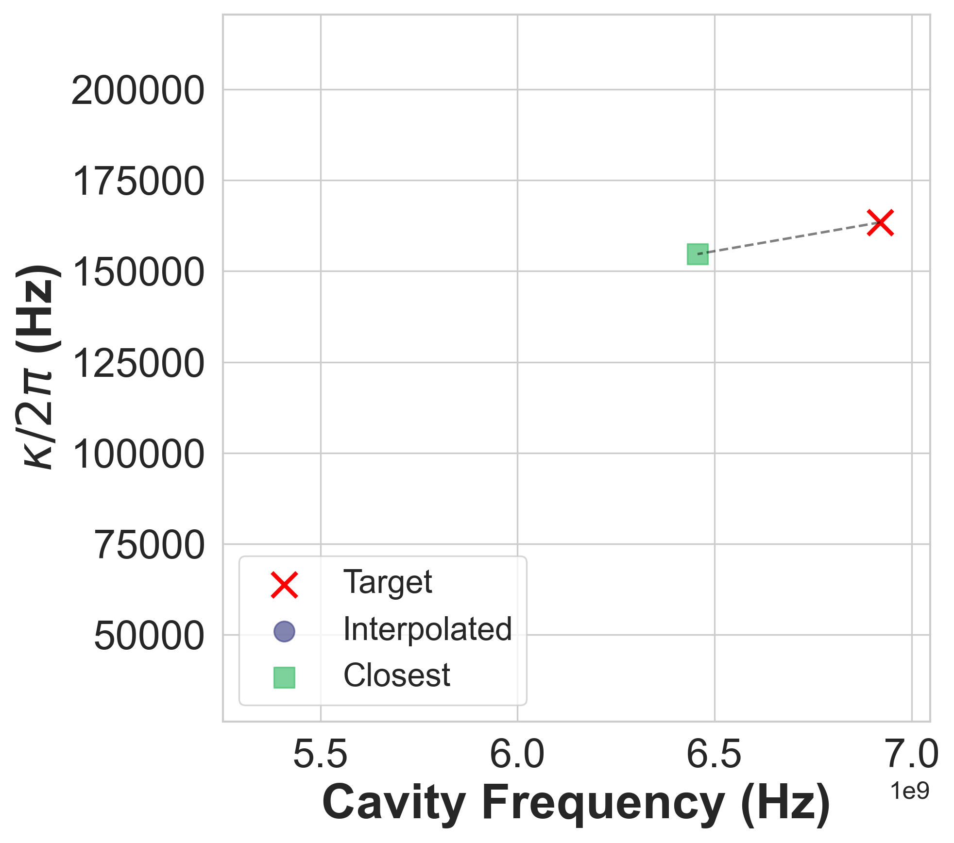
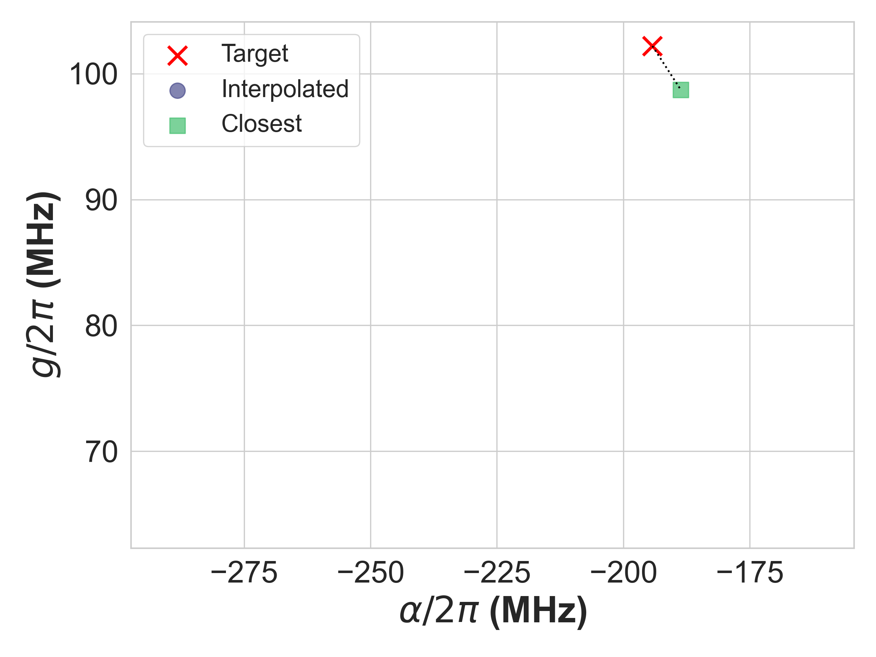
Interpolation Algorithm Validation
Choose Target $\hat{H}$ point $→$ SQuADDS finds closest design point
Notes:
SQuADDS finds for us the closest design for our target Hamiltonian. It then also generates a device design via the interpolation algorithm that we then simulate.

Slide 17

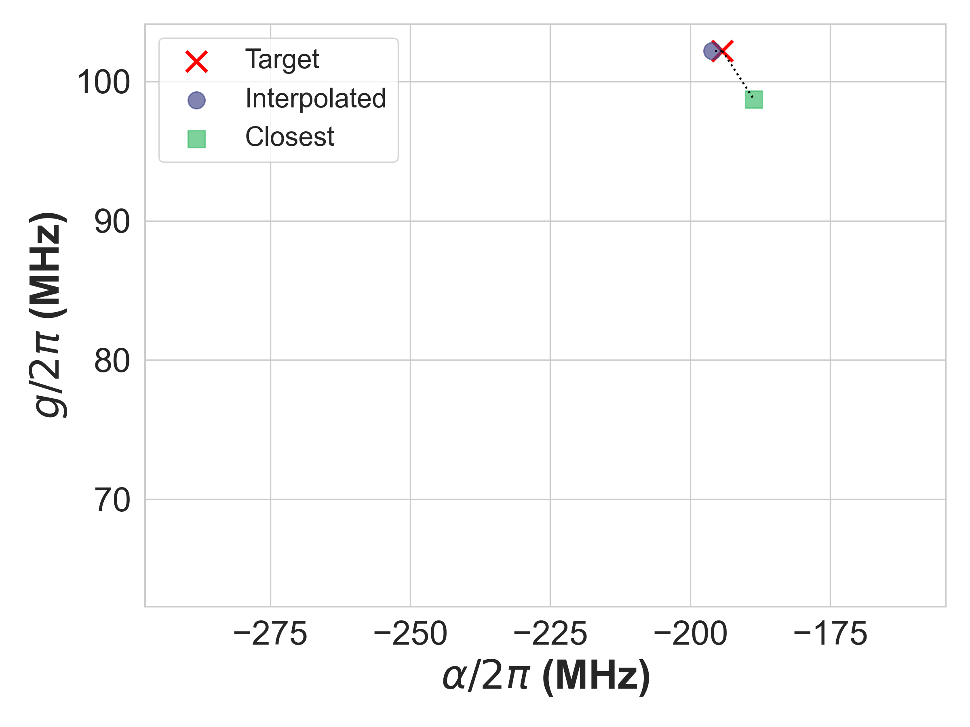
Interpolation Algorithm Validation
Choose Target $\hat{H}$ point $→$ SQuADDS finds closest design point $→$ Simulate the Interpolated Design
Notes:
As you can see, the interpolated design does a much better job at hitting our target Hamiltonian parameters.
We repeat this test by choosing other target Hamiltonian points.

Slide 18
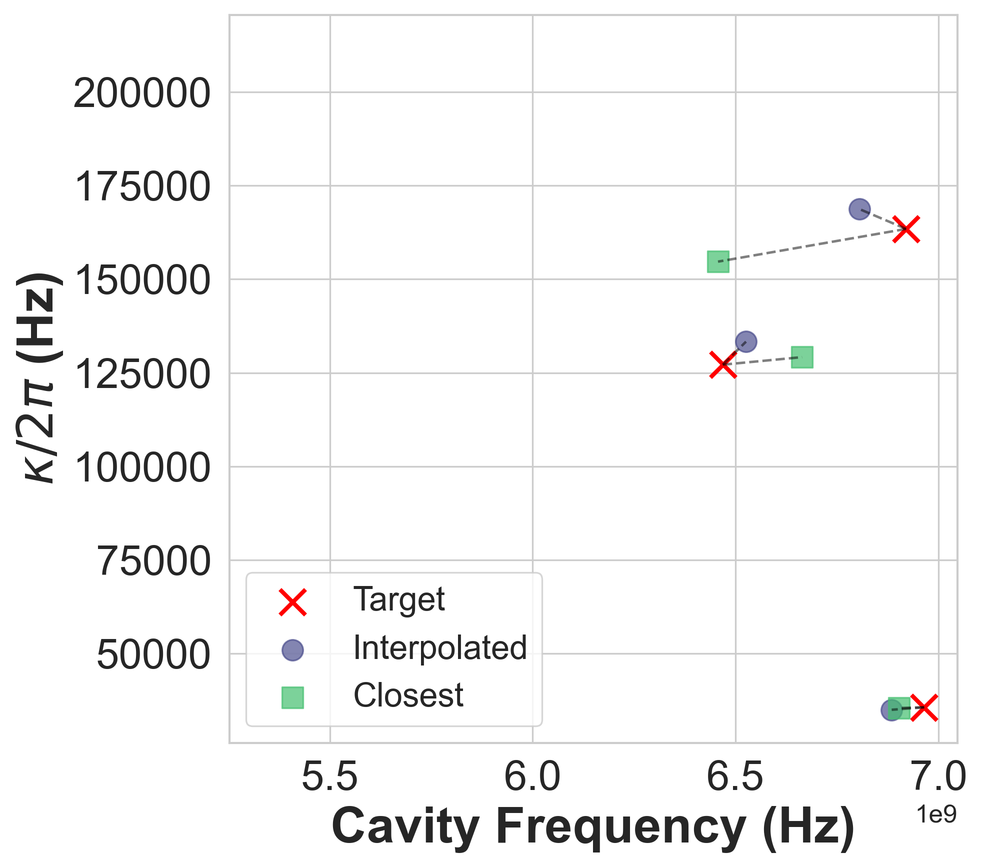
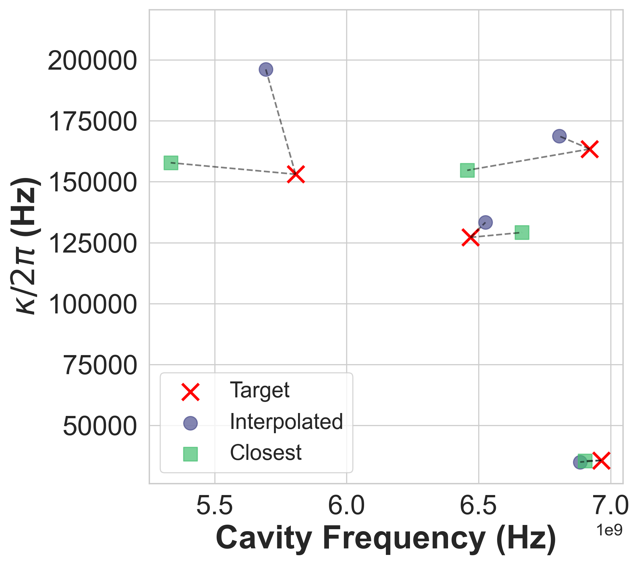
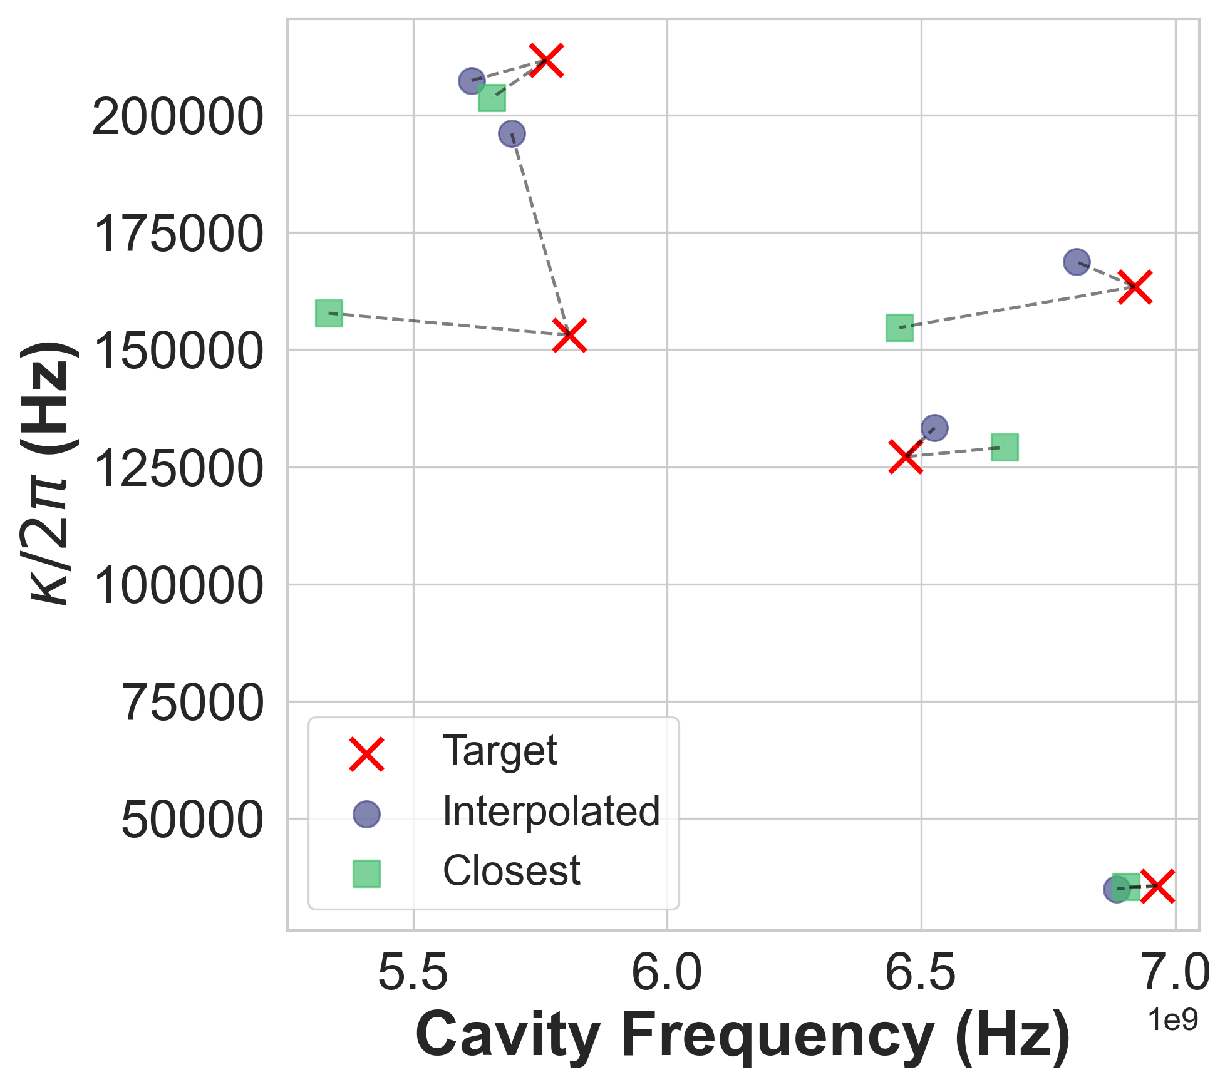
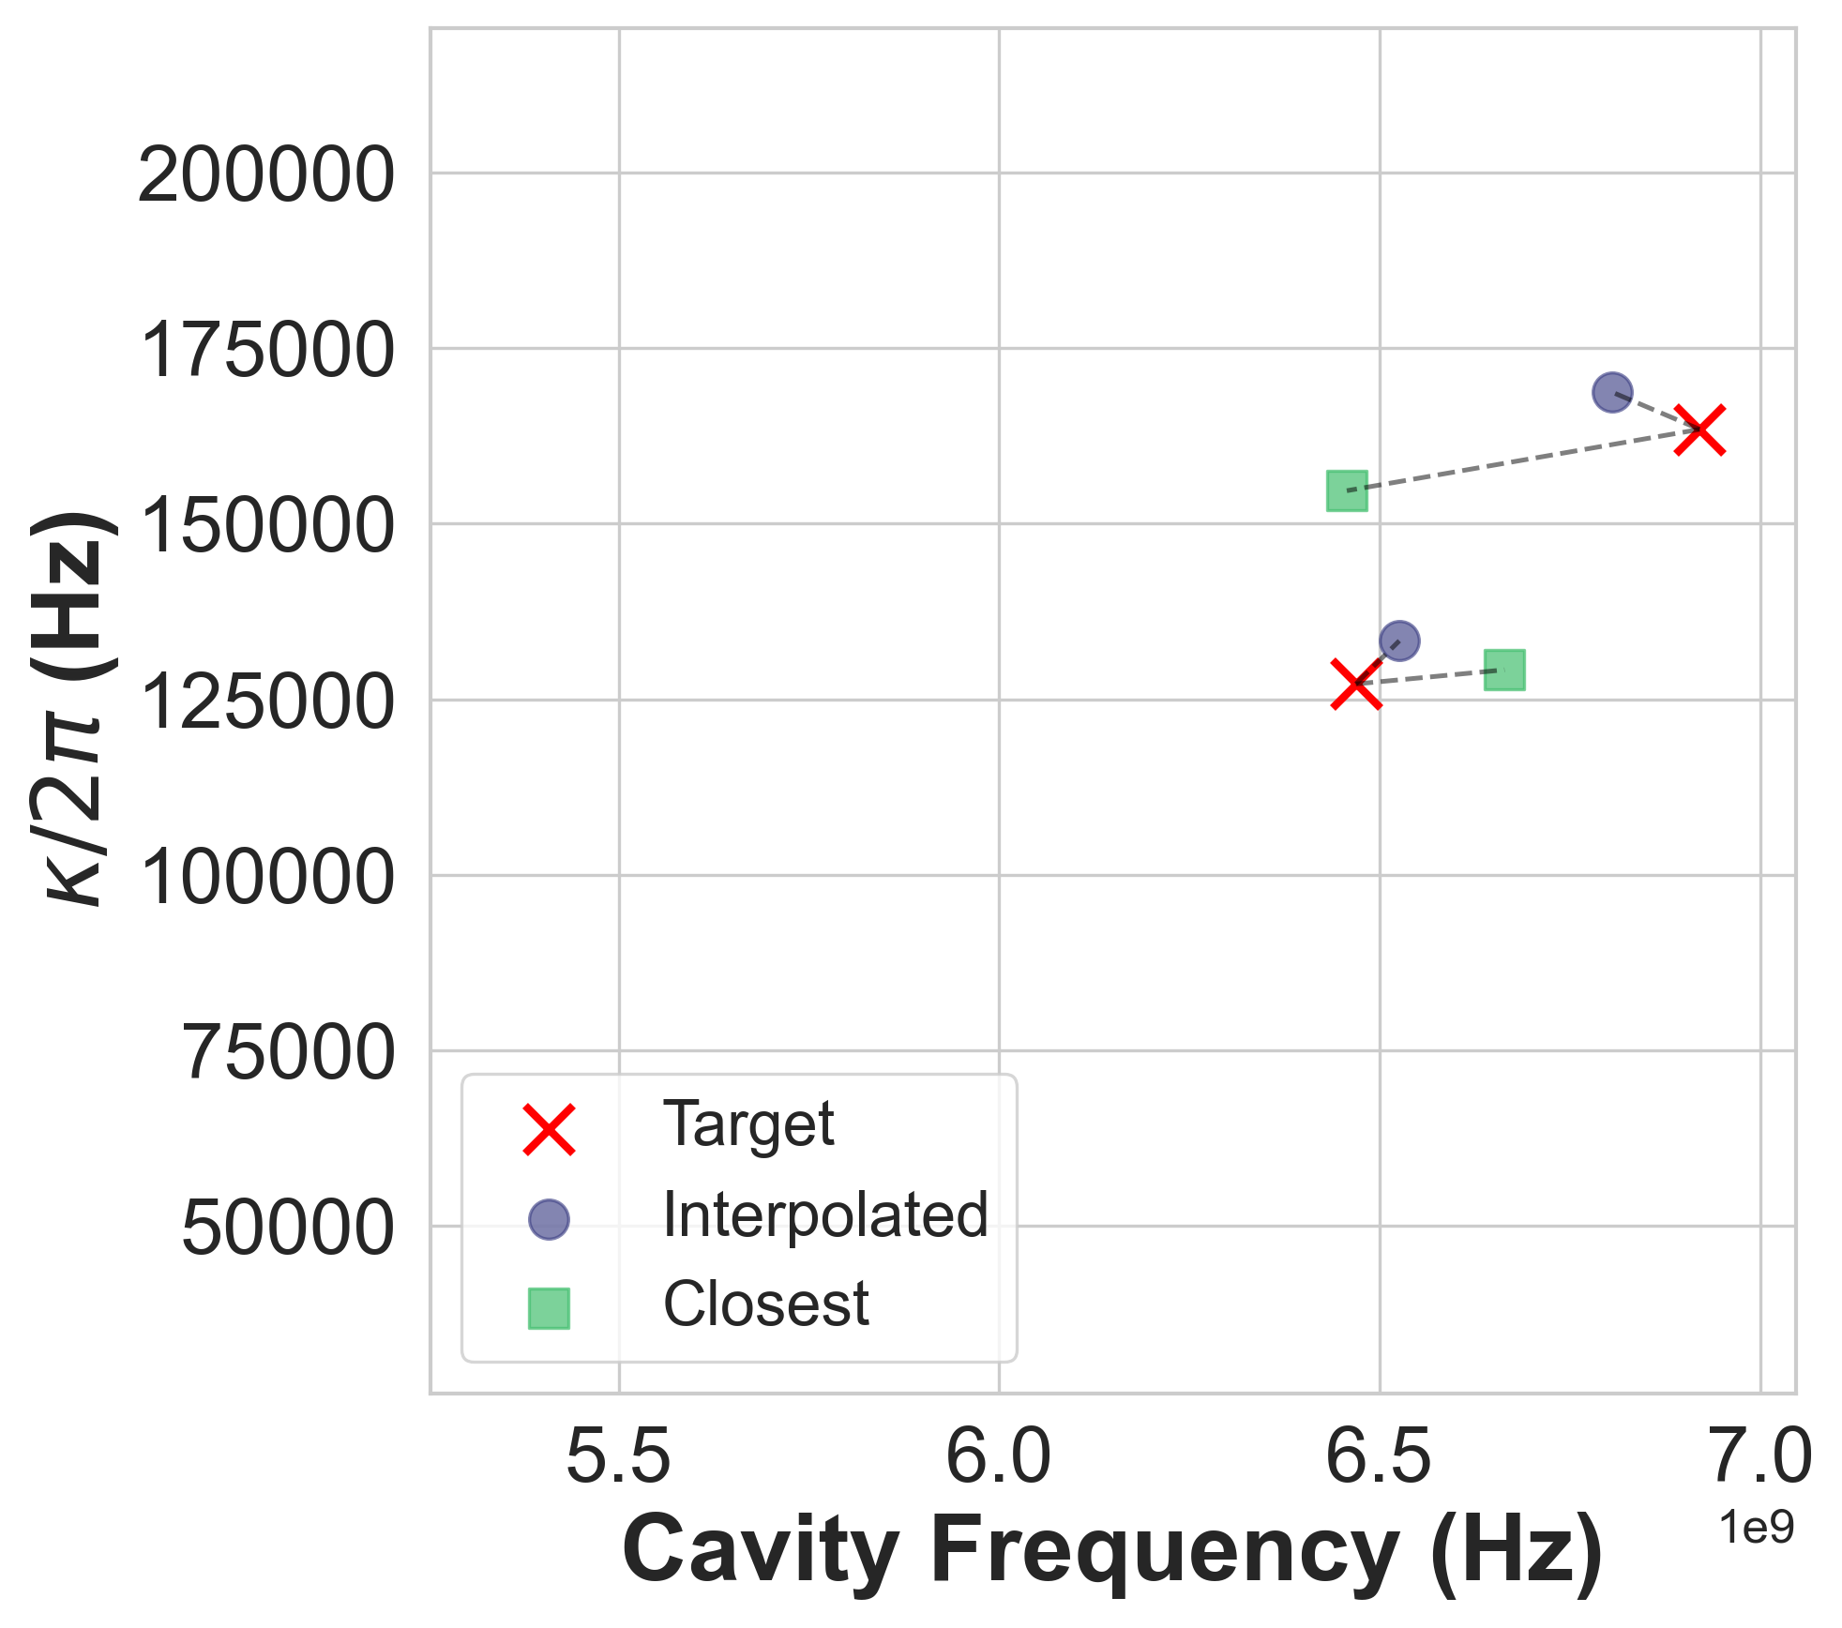
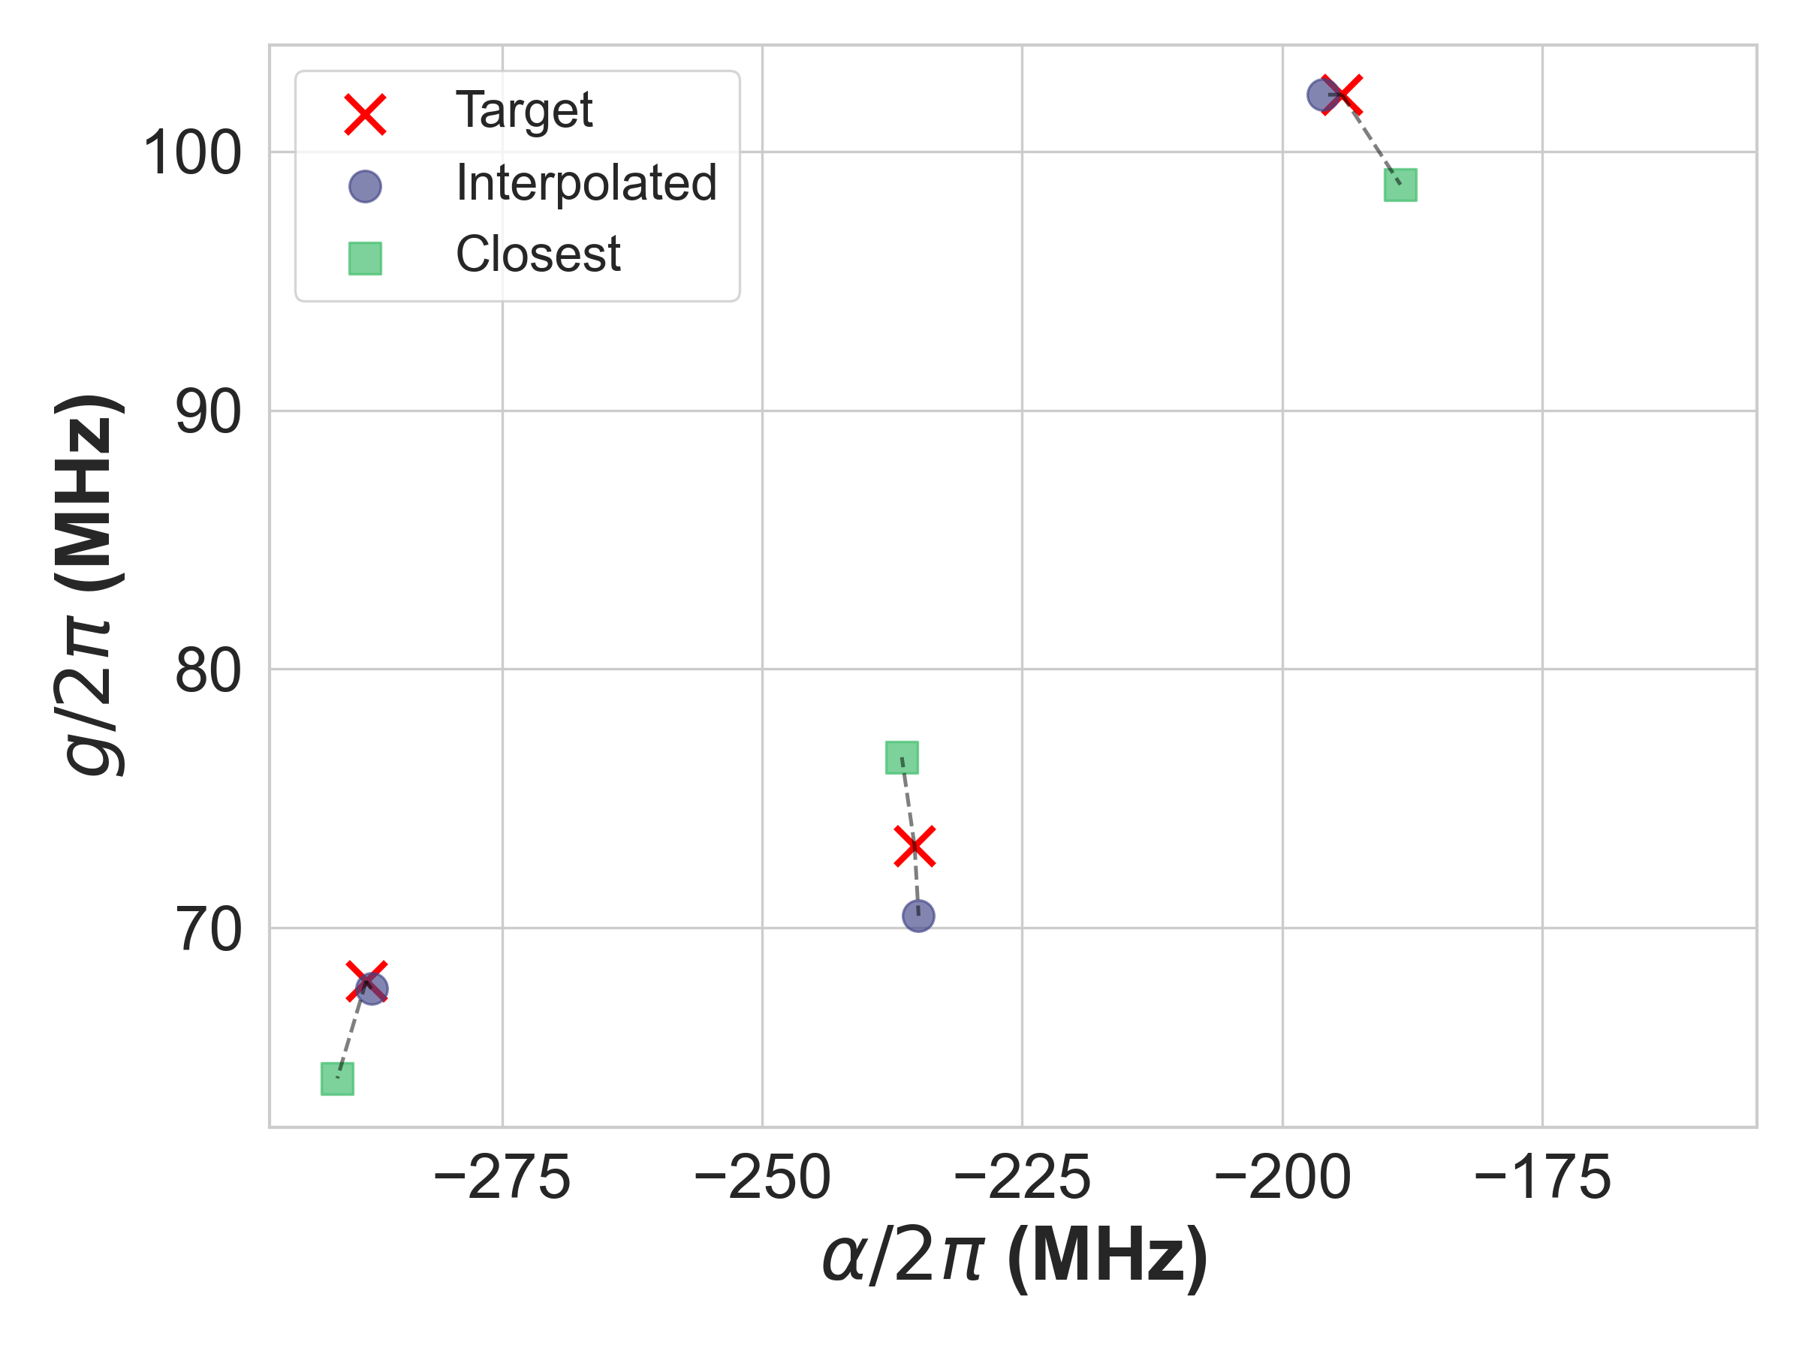
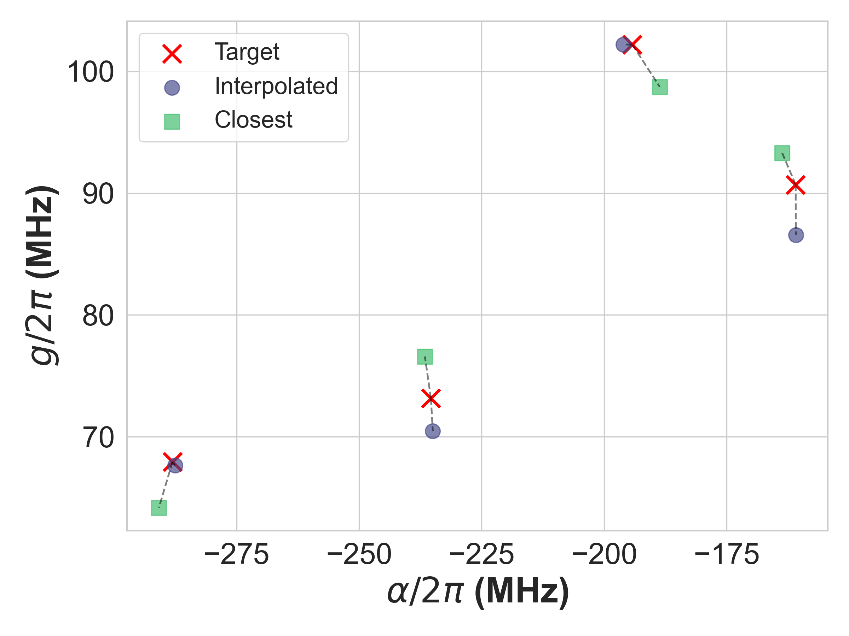

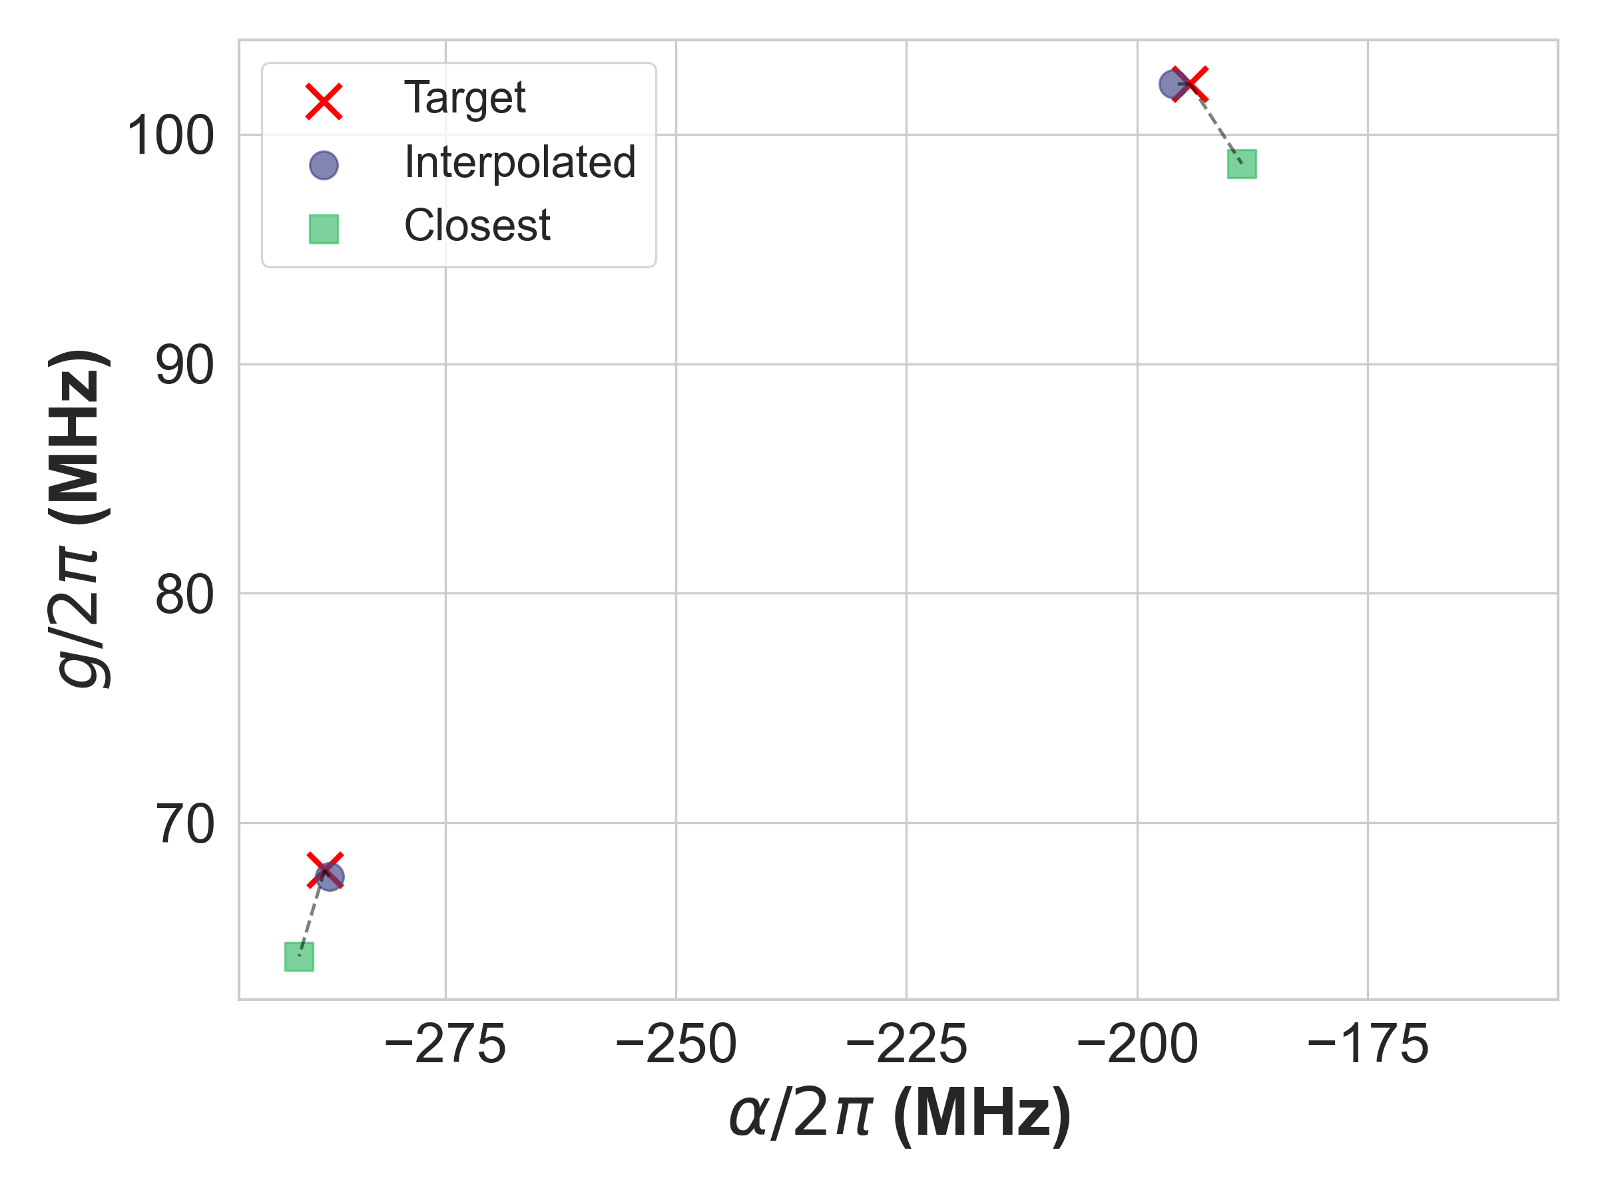
Interpolation Algorithm Validation

Slide 19
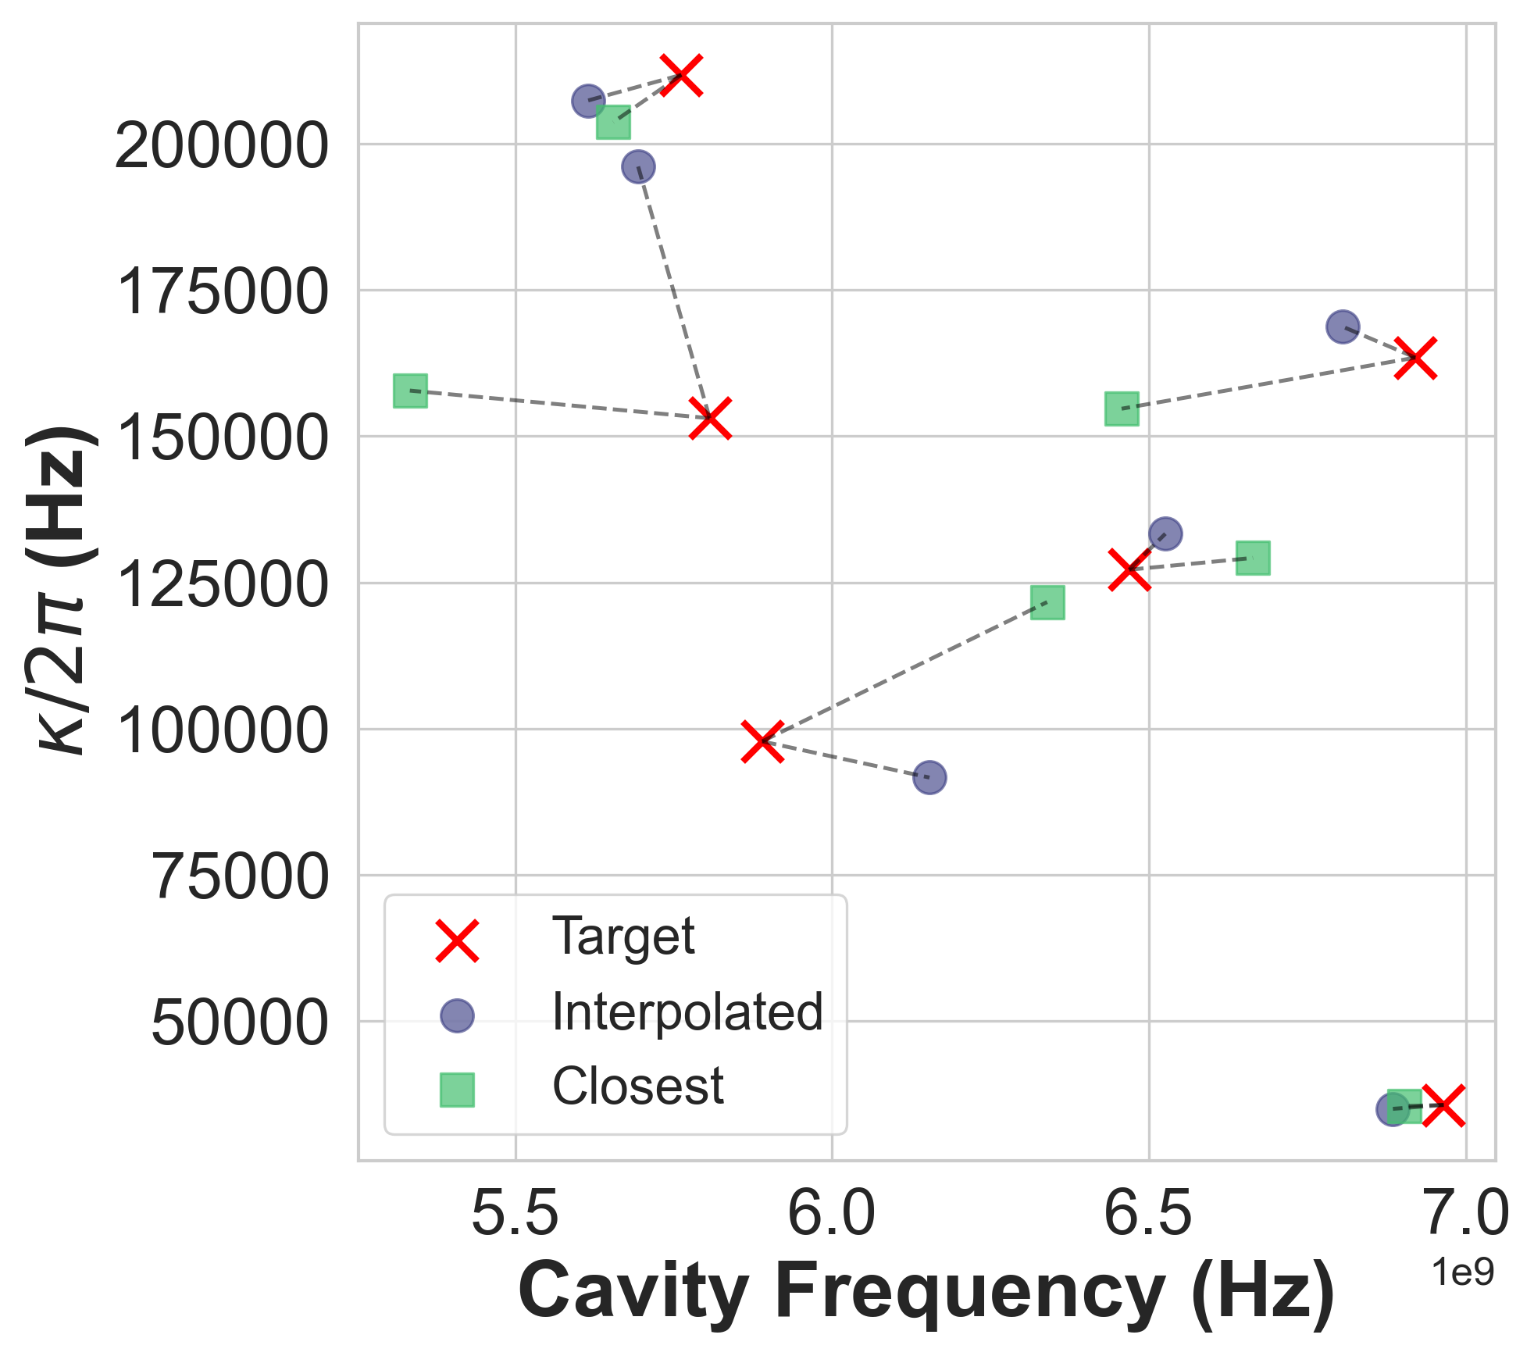
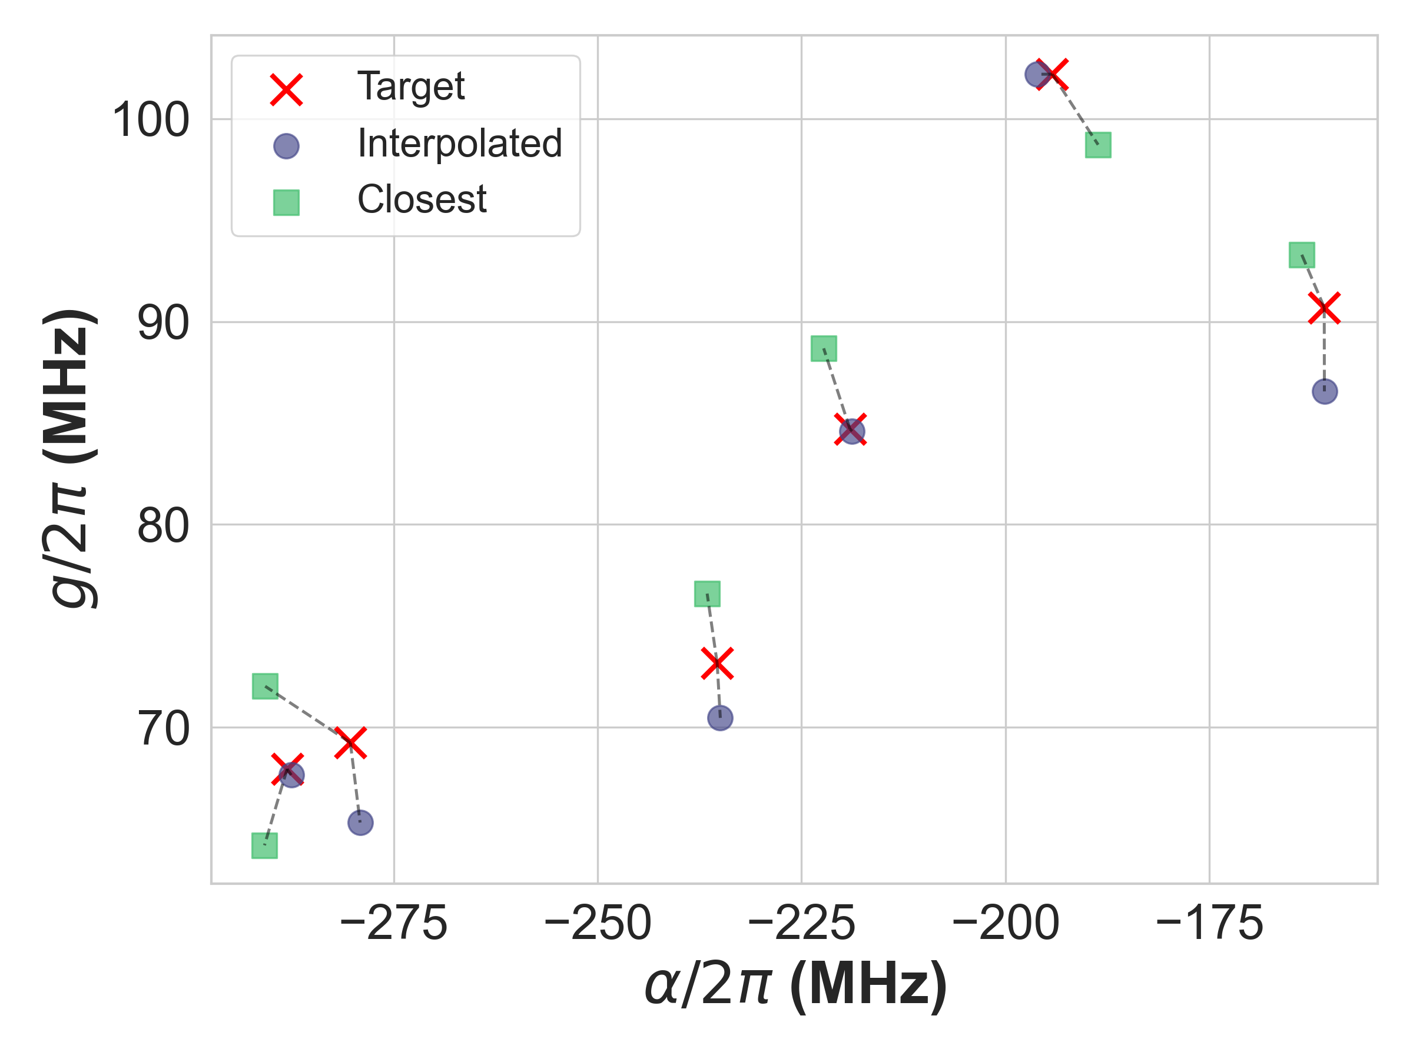
Interpolation Algorithm Validation
Target $\hat{H}$were both outside the convex bounds and locally sparse regions of pre-simulated points

Slide 20
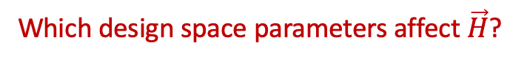
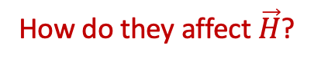
Workshop Objectives:
Learn how to use SQuADDS, qiskit-metal, palace, SQDMetal
Learn how to use ML systems to solve the interpolation problem
Learn about how we are using ML systems to solve the inverse design problem while not forgetting we are in the business of physics and not in the business of raising VC money
Which design space parameters affect $\vec{H}$?
How do they affect $\vec{H}$?

Slide 21
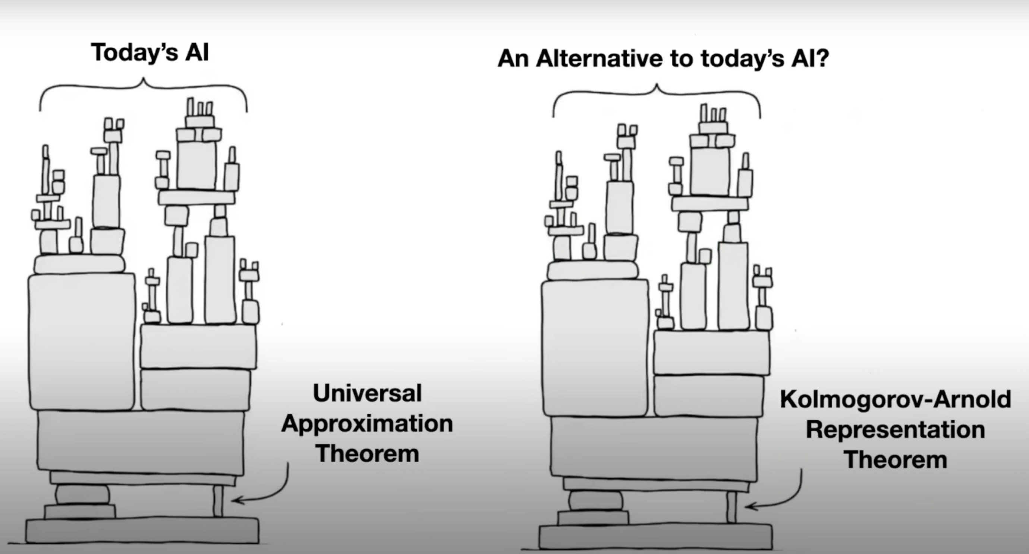
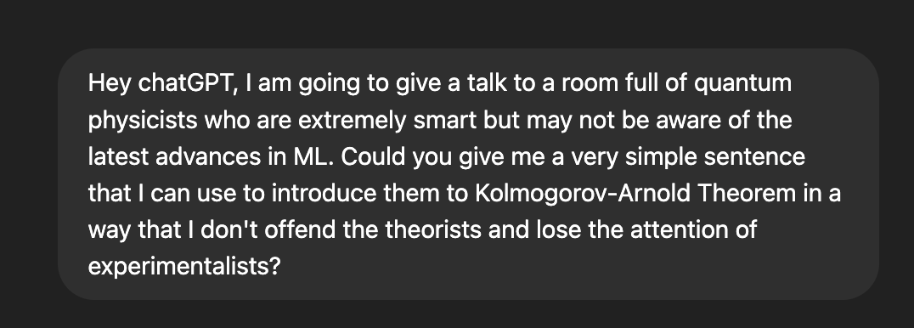
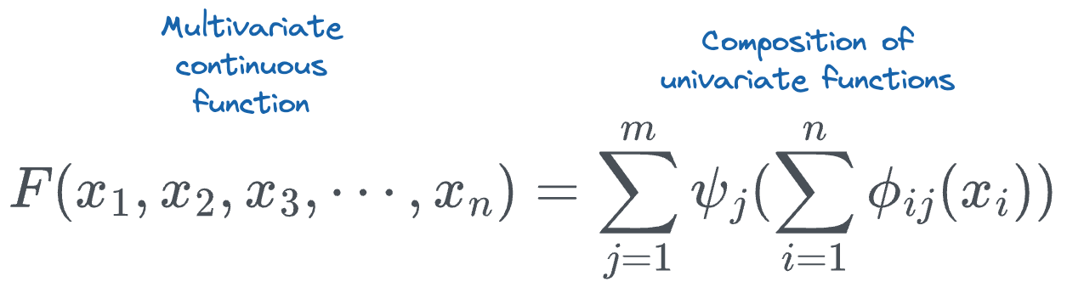
ML Crash Course: KANs
“The Kolmogorov–Arnold Theorem tells us something beautifully simple and powerful: that any multivariable continuous function can be built up from a sum of univariate functions — a kind of mathematical reassurance that even complex systems can be decomposed into simpler parts.”

Slide 22
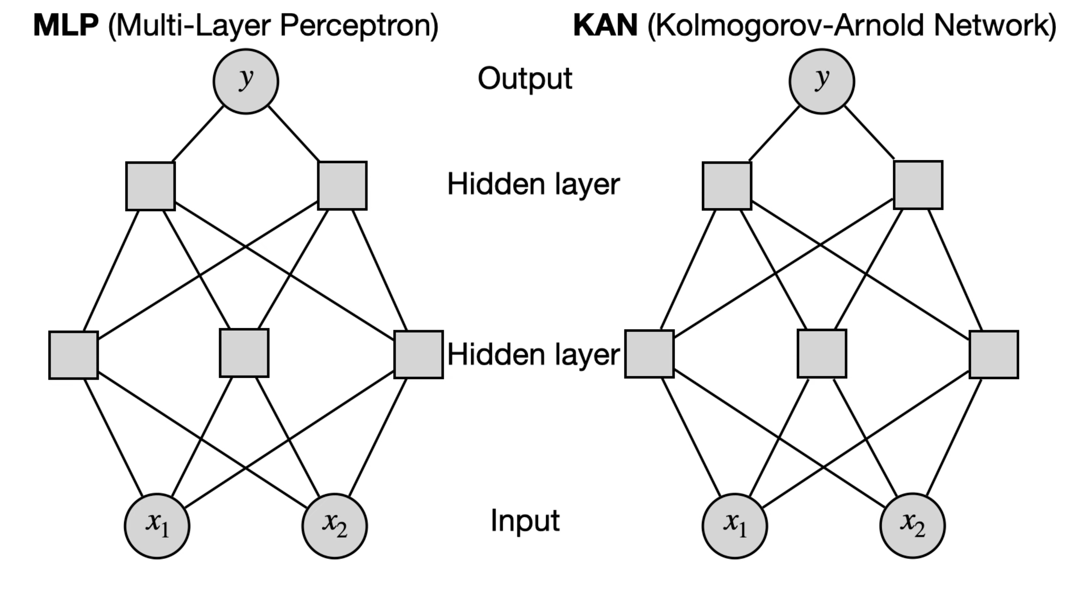
ML Crash Course: KANs
^{Courtesy} ^{of Serrano Academy}

Slide 23
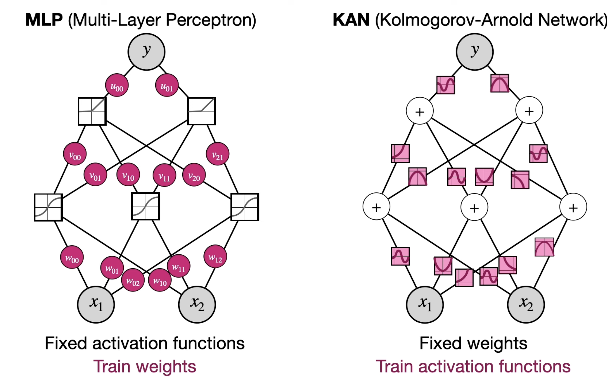
ML Crash Course: KANs
^{Courtesy} ^{of Serrano Academy}

Slide 24
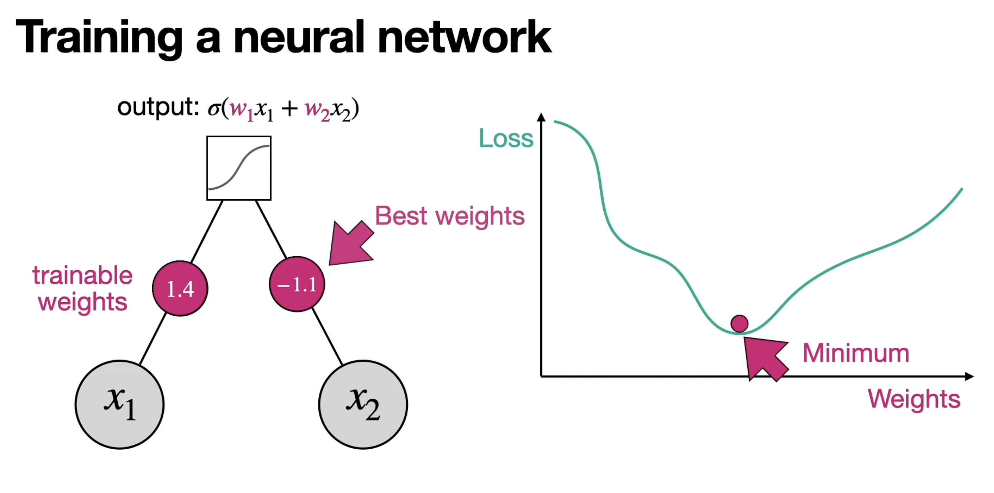
ML Crash Course: KANs
^{Courtesy} ^{of Serrano Academy}

Slide 25
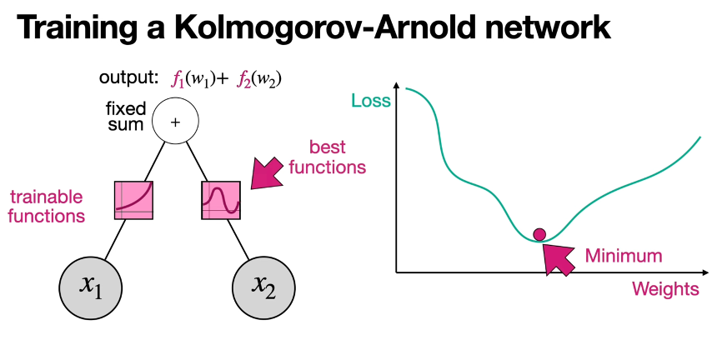
ML Crash Course: KANs
^{Courtesy} ^{of Serrano Academy}

Slide 26
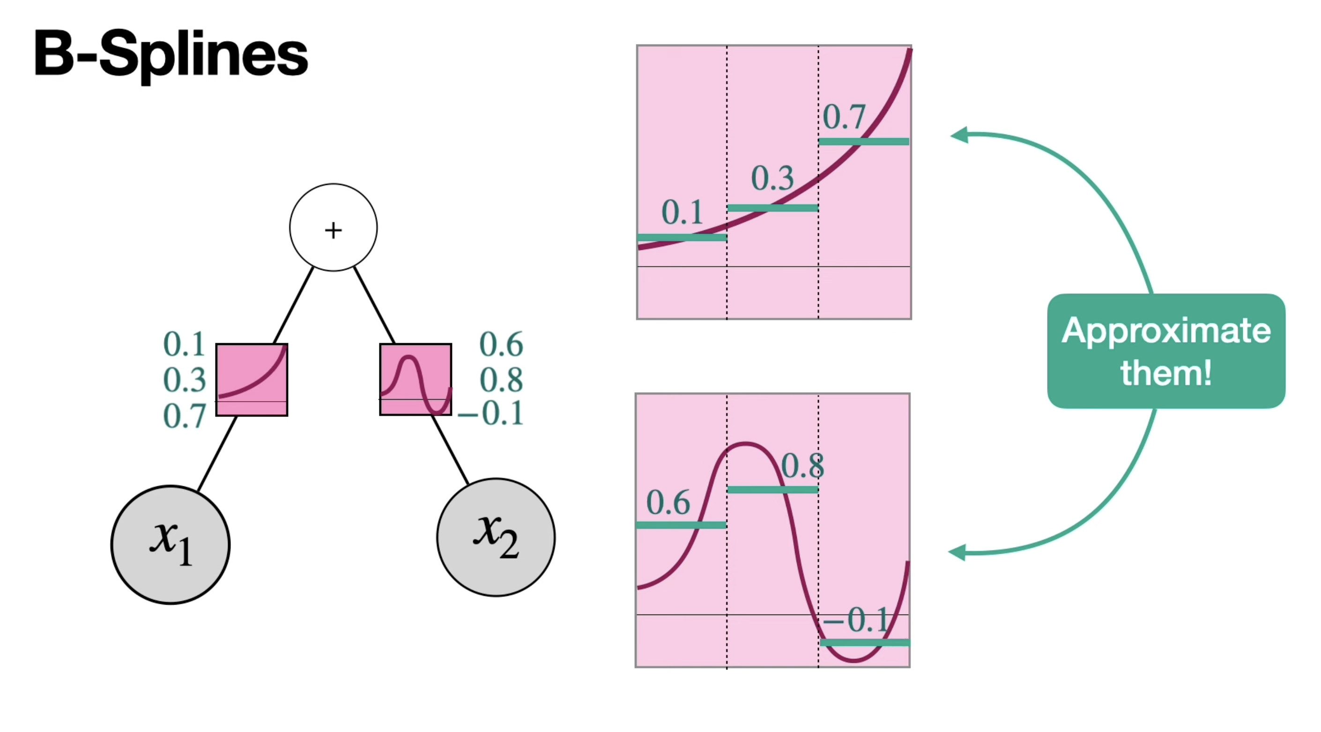
ML Crash Course: KANs
^{Courtesy} ^{of Serrano Academy}

Slide 27
Workshop Time ⏰

Slide 28

https://quantum-la.social

Slide 29
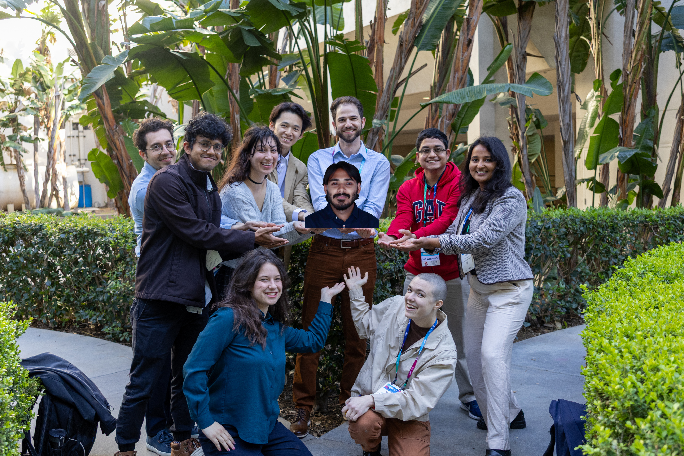

Thanks!
Contribution Portal
shanto@usc.edu
squadds-portal.vercel.app
Paper
GitHub
HuggingFace
Docsite
doi.org/10.22331/q-2024-09-09-1465
LFL-Lab/SQuADDS
SQuADDS/SQuADDS_DB
lfl-lab.github.io/SQuADDS/

